Slide 1
The Power of Learning
With YouTube
By Perry Nelson
Information Specialist

Slide 2
What’s YouTube?
Free, video-hosting platform owned by Google
Huge, filled with content, including:
Music (and music videos)
Web series
Video reviews (of books, of television, of movies)
Tutorials
Anything!

Slide 3
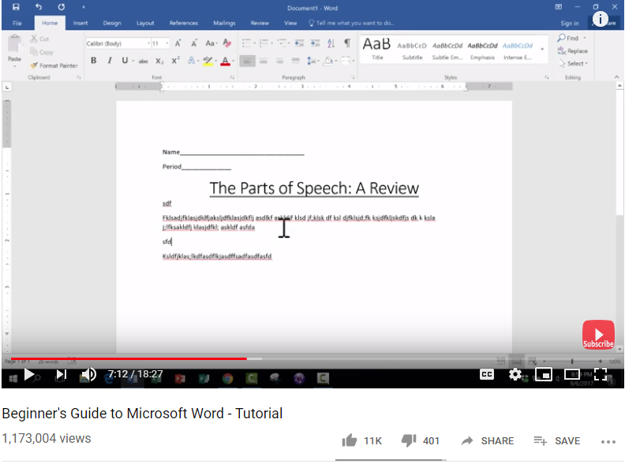
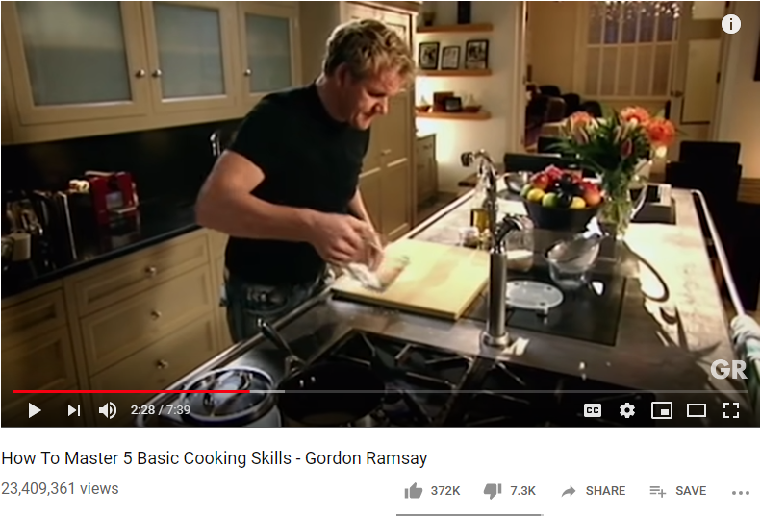
YouTube Tutorials

Slide 4
Thank You
Want a copy of this presentation?
Visit www.skokielibrary.info/handouts
where this presentation will be available
for four weeks.

