Slide 1
Excel 2016
Charts for Science
By Martha Nelson
Information Specialist

Slide 2
Charts communicate information visually
Notes:
At Skokie Public Library, we have Excel 2016
To start Excel, click on the Start button on the lower left corner, then click on the green Excel icon. If the icon isn’t there, enter “Excel” in the search field and press enter.

Slide 3
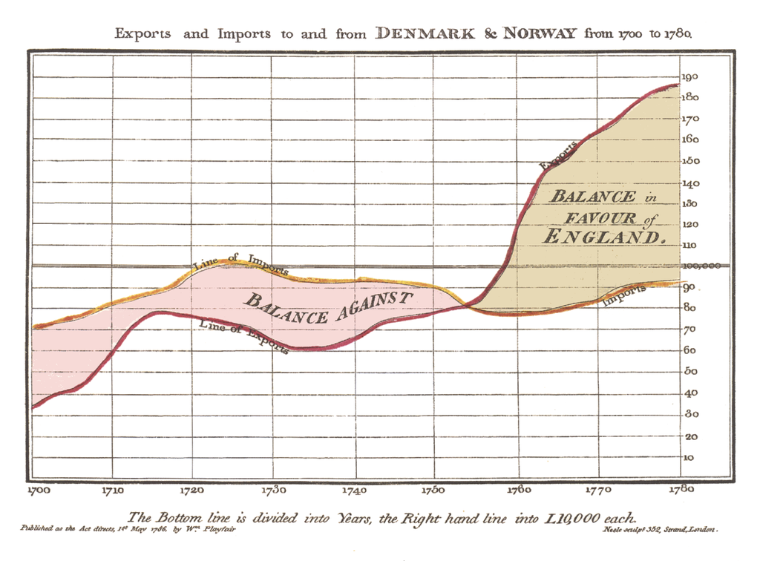
William Playfair - 1786
Charts communicate information visually
Notes:
At Skokie Public Library, we have Excel 2016
To start Excel, click on the Start button on the lower left corner, then click on the green Excel icon. If the icon isn’t there, enter “Excel” in the search field and press enter.

Slide 4
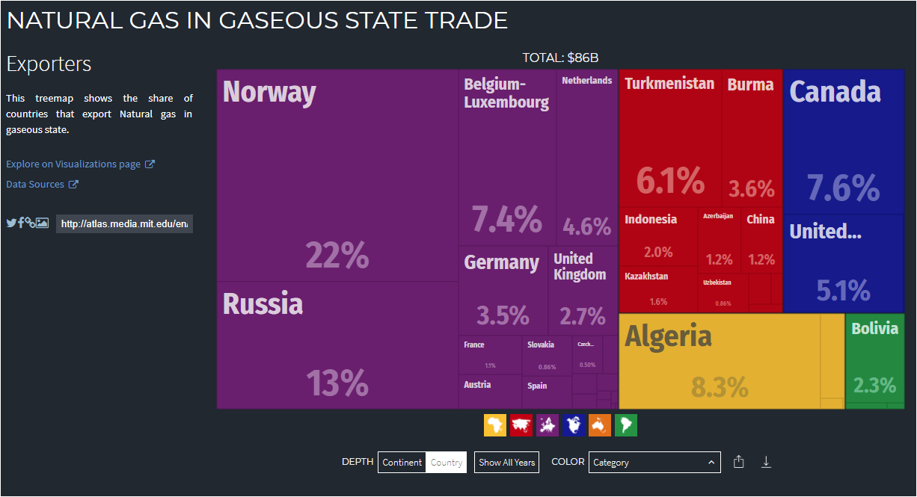
MIT’s Observatory of Economic Complexity for world trade
https://atlas.media.mit.edu/en/

Slide 5
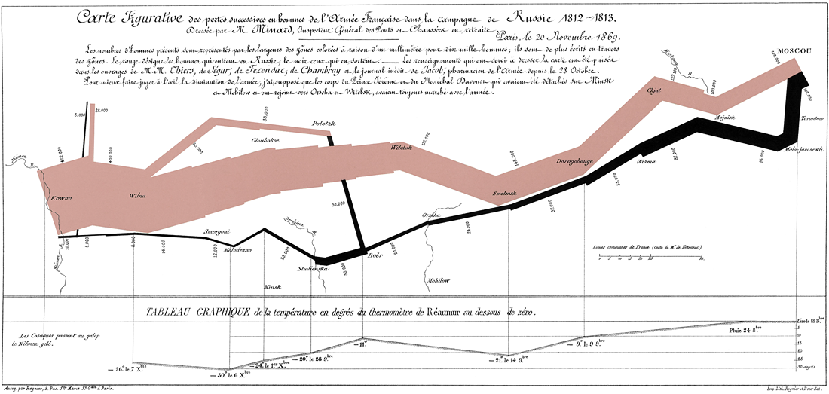
Charles Joseph Minard: Napoleon's Retreat From Moscow (The Russian Campaign 1812-1813)

Slide 6
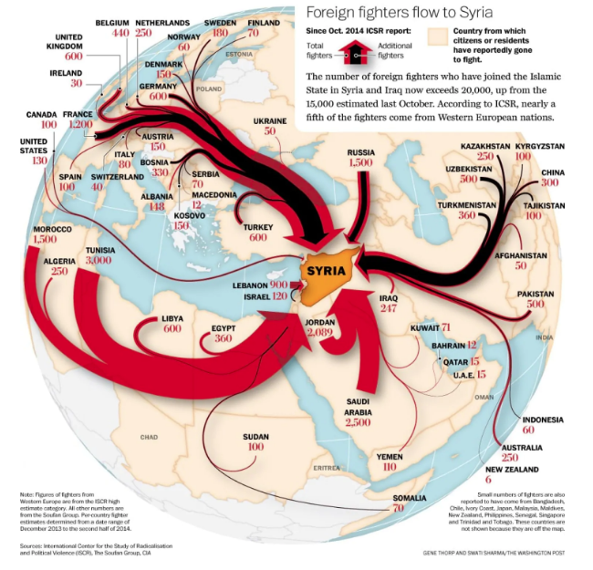
Flow Map
Notes:
Map: How the flow of foreign fighters to Iraq and Syria has surged since October
By Swati Sharma
Swati Sharma Digital editor
January 27, 2015

Slide 7
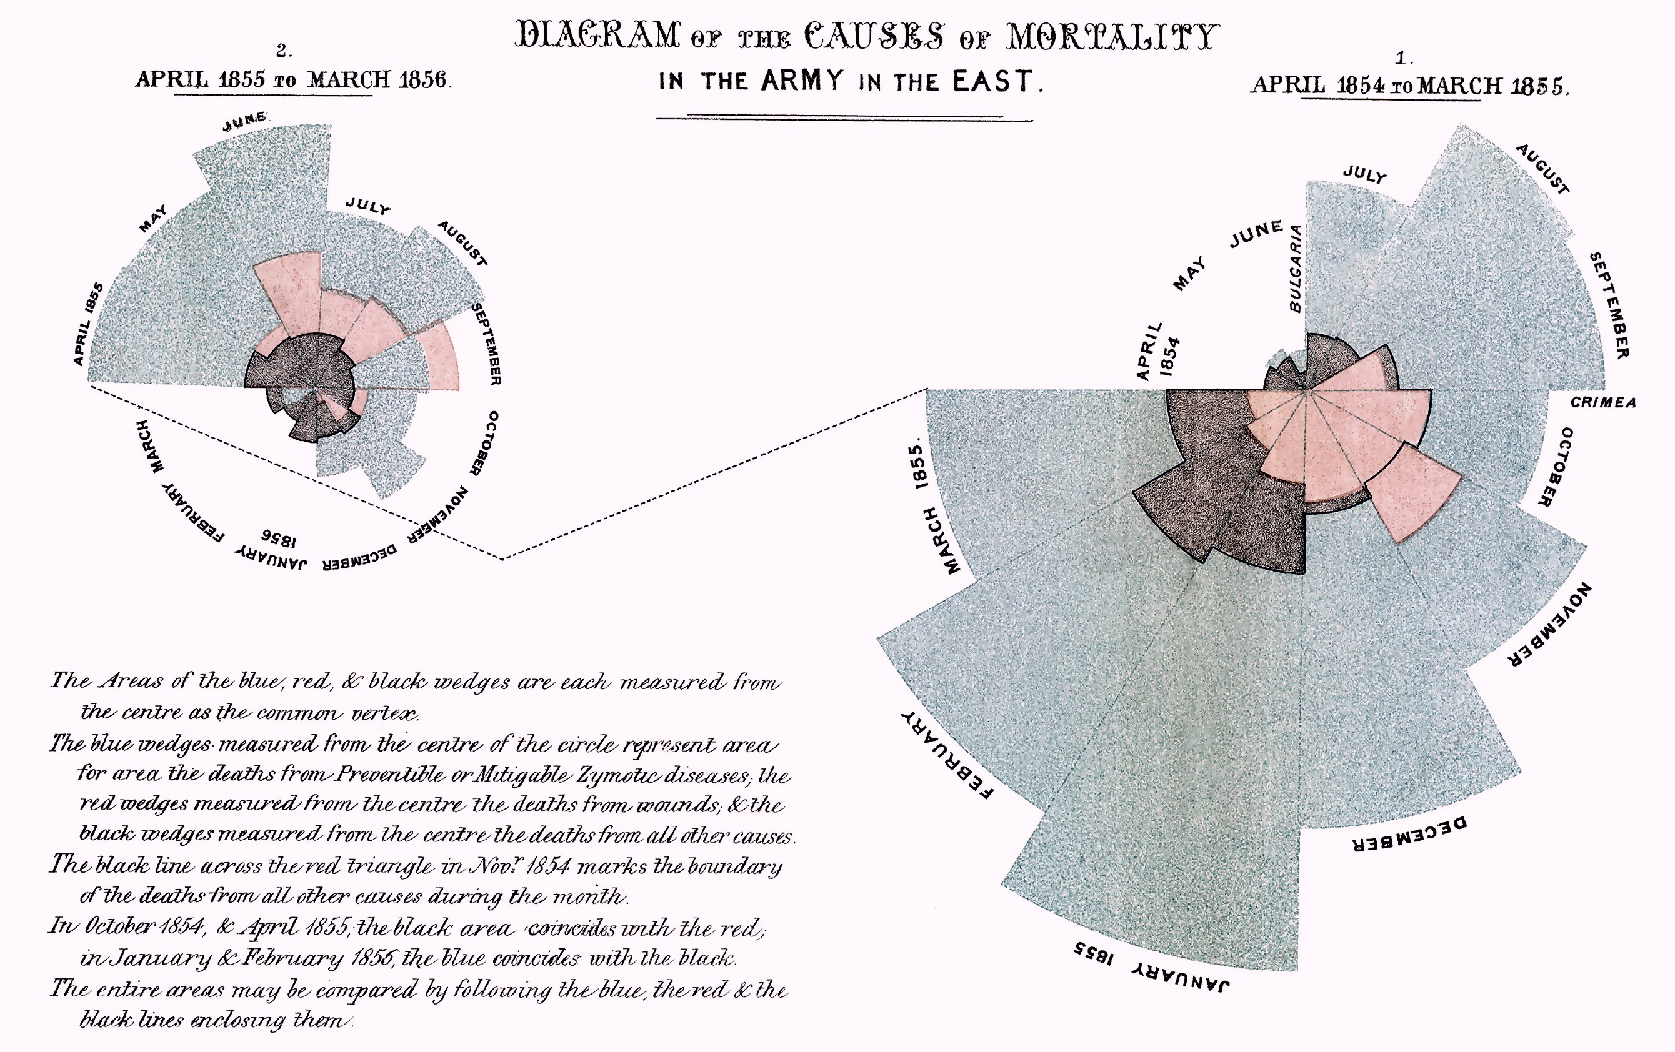
Florence Nightingale’s Coxcomb chart - 1858
Notes:
https://www.theguardian.com/news/datablog/2010/aug/13/florence-nightingale-graphics
We all have an image of Nightingale - who died 100 years ago today - as a nurse, lady with the lamp, medical reformer and campaigner for soldiers' health. But she was also a datajournalist.
After the disasters of the Crimean war, Florence Nightingale returned to become a passionate campaigner for improvements in the health of the British army.
She developed the visual presentation of information, including the pie chart, first developed by William Playfair in 1801. Nightingale also used statistical graphics in reports to Parliament, realising this was the most effective way of bringing data to life.

Slide 8
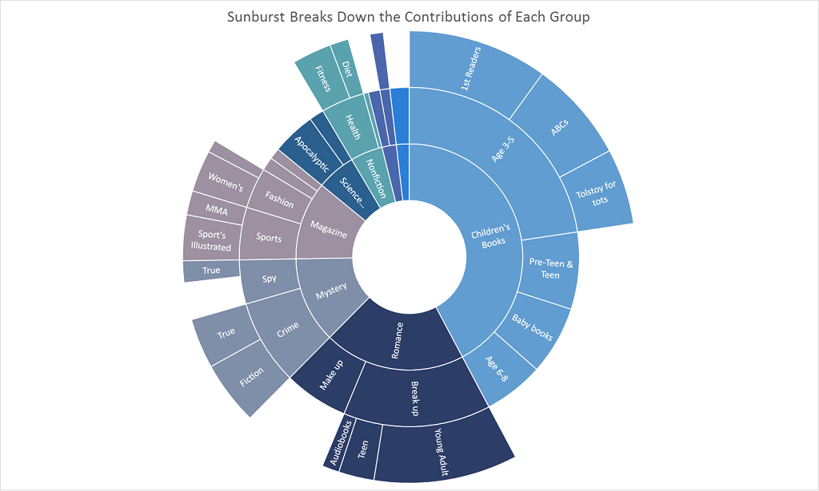
Sunburst Chart made with Excel

Slide 9
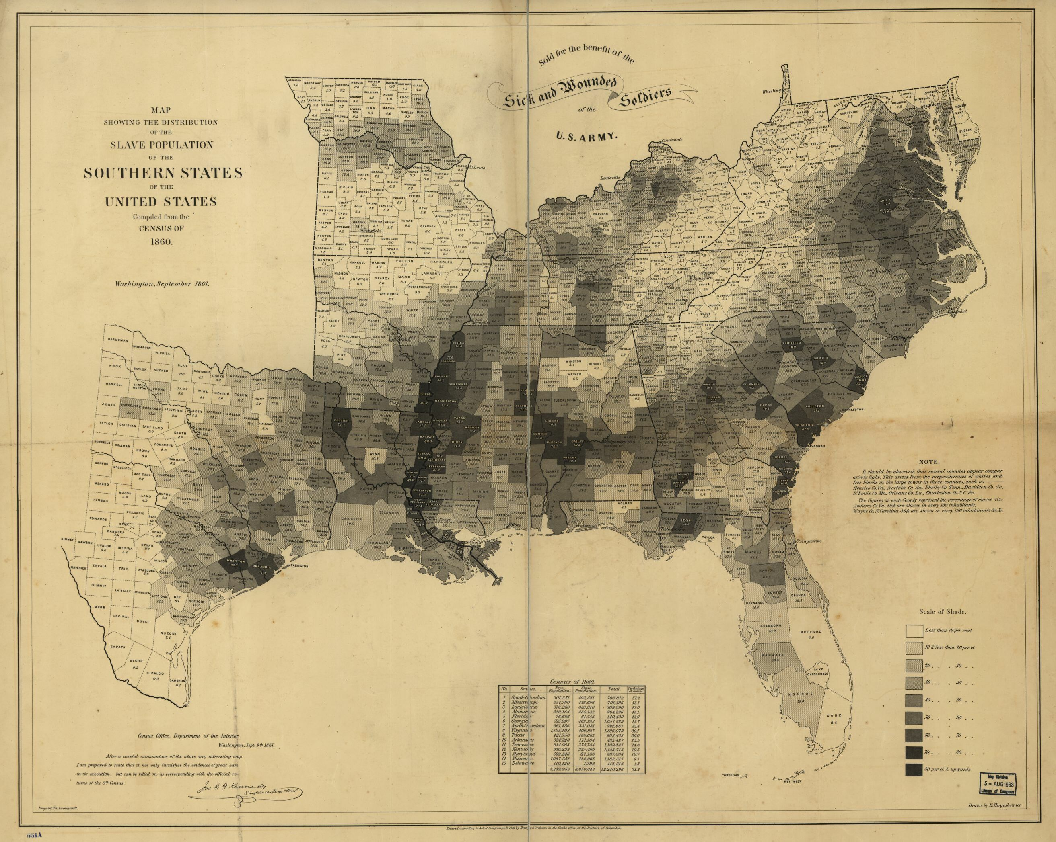

Slide 10
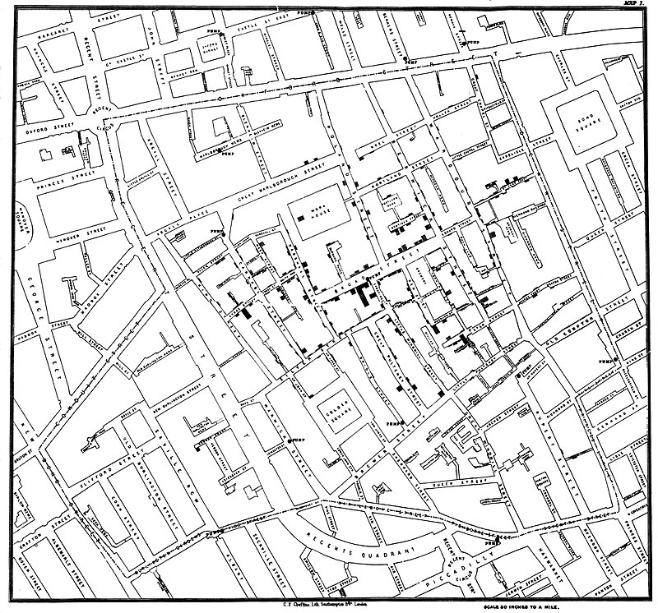
Dr. John Snow’s Cholera map 1854
Notes:
John Snow (15 March 1813 – 16 June 1858) was an English physician and a leader in the adoption of anesthesia and medical hygiene. He is considered one of the fathers of modern epidemiology, in part because of his work in tracing the source of a cholera outbreak in Soho, London, in 1854. His findings inspired fundamental changes in the water and waste systems of London, which led to similar changes in other cities, and a significant improvement in general public health around the world.

Slide 11
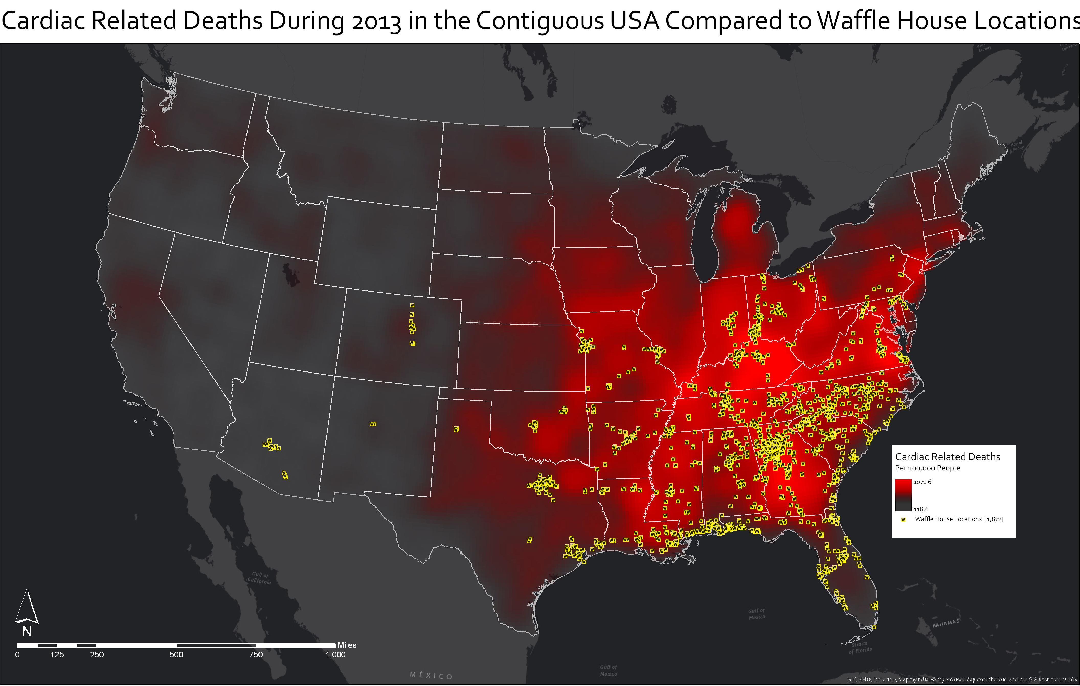
Data: CDC and Waffle House
Tools: ArcGIS Pro

Slide 12
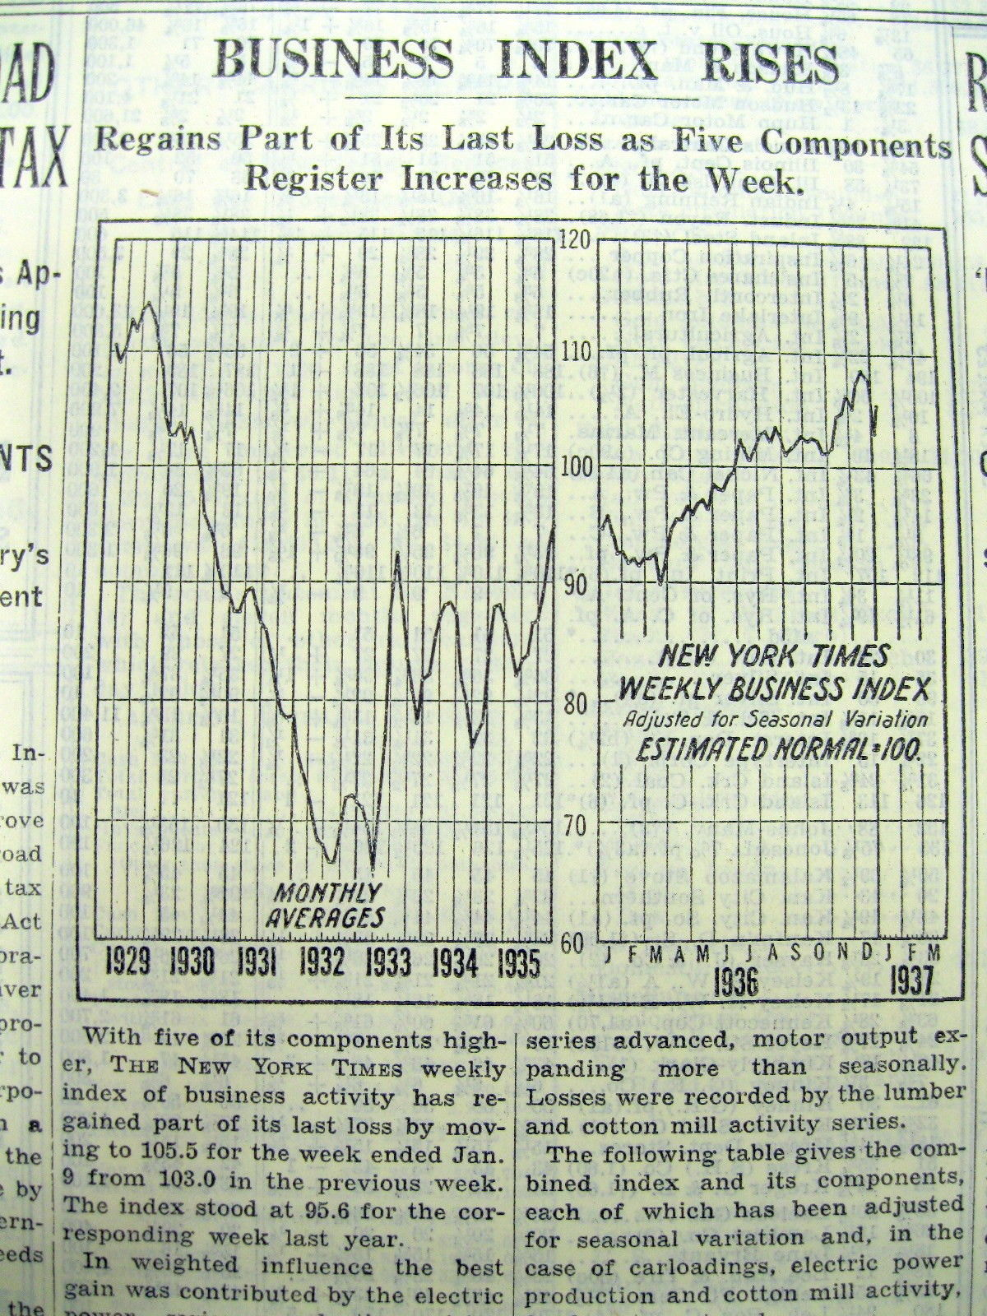
An historic line graph

Slide 13
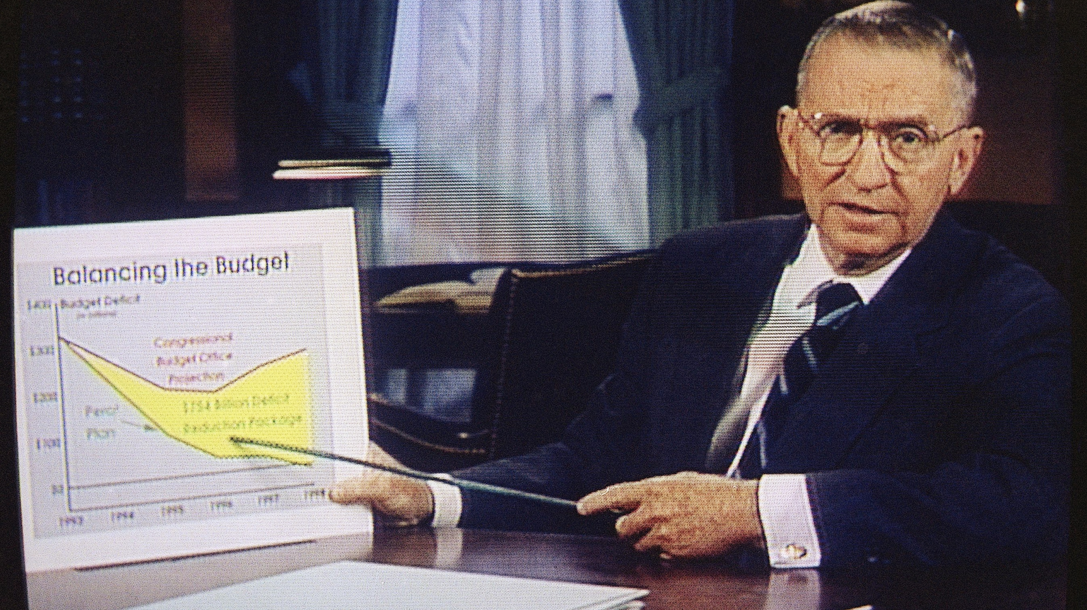
H Ross Perot -1992
Notes:
Henry Ross Perot born June 27, 1930) is an American business magnate and former politician. As the founder of the successful Electronic Data Systems corporation, he became a billionaire. He ran an independent presidential campaign in 1992 and a third party campaign in 1996, establishing the Reform Party in the latter election. Both campaigns were among the strongest presidential showings by a third party or independent candidate in U.S. history.

Slide 14
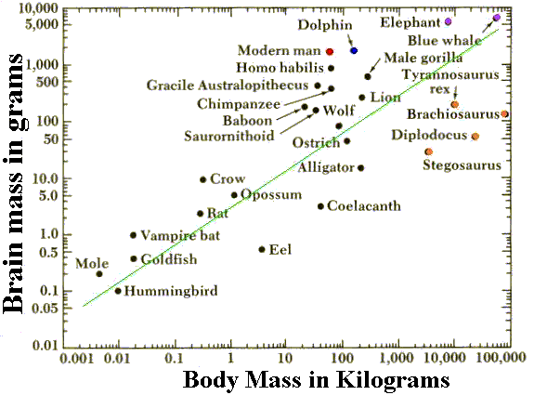
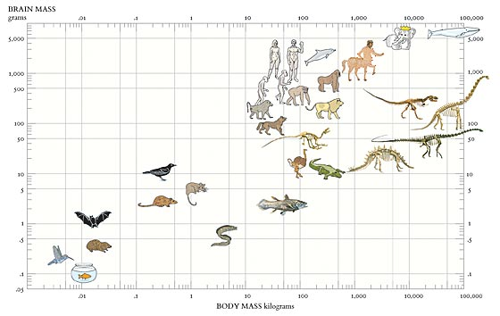
Edward Tufte
Original chart by Carl Sagan
Notes:
Edward Rolf Tufte born March 14, 1942) is an American statistician and professor emeritus of political science, statistics, and computer science at Yale University. He is noted for his writings on information design and as a pioneer in the field of data visualization.

Slide 15

Things I think about before creating a chart

Slide 16

Who is your audience?

Slide 17
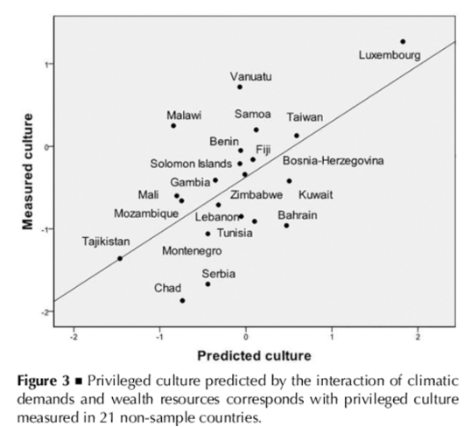
How it will be used
Print or online?
JSTOR retrieved article
Notes:
Charts published in most scientific publications, which are carried in JSTOR, are in black and white. They are static, meaning that they stay the same for the life of the article.
Charts published on websites are very colorful and can be dynamic. They can change every second, or stay the same.

Slide 18
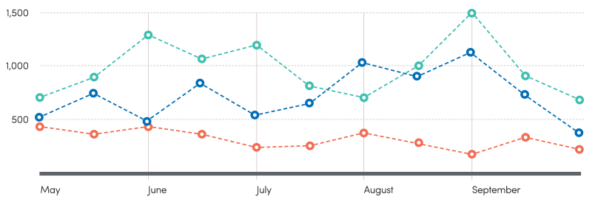
Where will you get your data?
Personal data you have collected
From an employer
Government websites
Wikipedia, ESPN, Dow Jones
Notes:
See the handout for good places to find practice data.

Slide 19
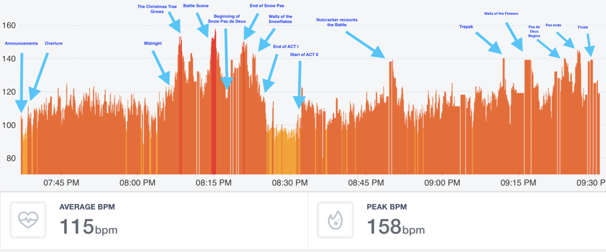
    A conductor wore a heart monitor during The Nutcracker. He annotated his Health app report
    - AeroMaestro

Slide 20
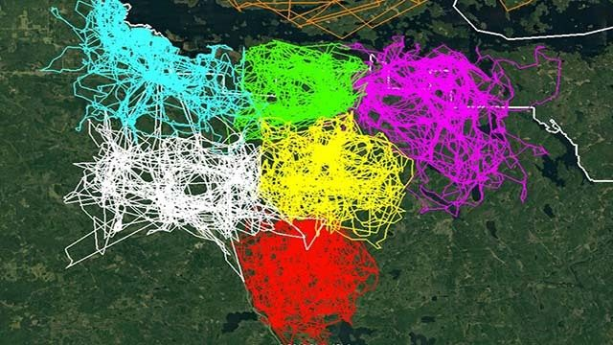
Minnesota's Voyageurs Wolf Project data maps
Notes:
https://www.news8000.com/news/minnesota-s-voyageurs-wolf-project-releases-data-maps/917358276
The Voyageurs Wolf Project of Minnesota released GPS maps from this past summer's research.
Seven wolves, in different packs, were monitored this past summer. Each wolf's collar took location readings every 20 minutes for the duration of the summer, with the exception of the northernmost pack which took location readings every four hours starting in October.

Slide 21

Sleep patterns of the first six months of an infant’s life.
Tracked using: Baby Connect iPhone app.
CAD package Rhinoceros with Grasshopper plugin
Adobe Illustrator for colors

Slide 22
What software will you use?
R – statistics program
Excel – Microsoft Office spreadsheet
Python – web dev language
Chart generators on the web
Google Sheets & charts
Notes:
https://trends.google.com/trends/?geo=US

Slide 23
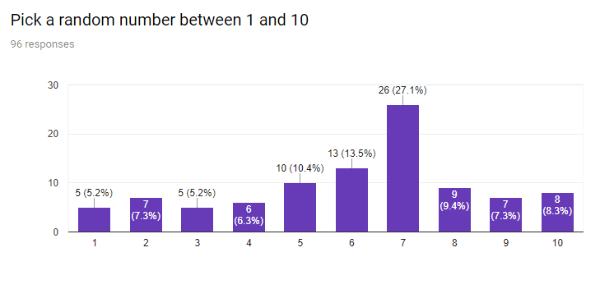
Google forms
Google Charts (all free!)

Slide 24
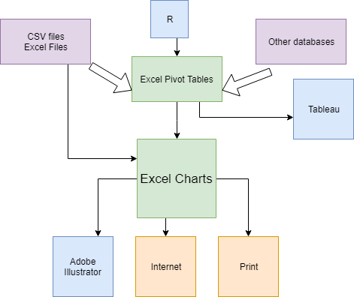
Many possible ways and processes to create a wonderful chart for science

Slide 25
Beyond Excel:
Microsoft Power BI
Tableau
QlikView
Illustrator and other image / photo programs

Slide 26
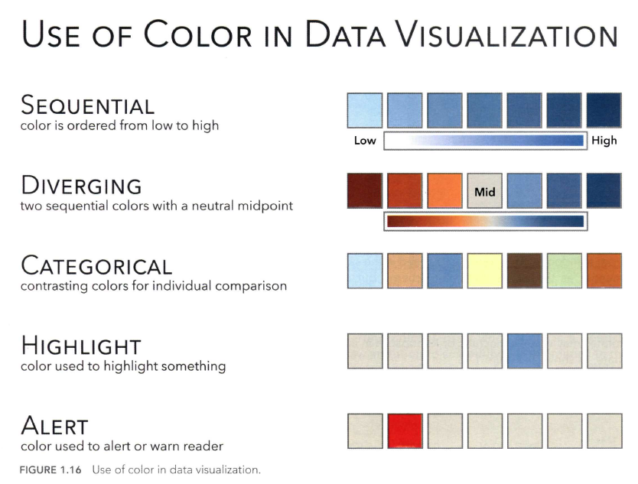

Slide 27
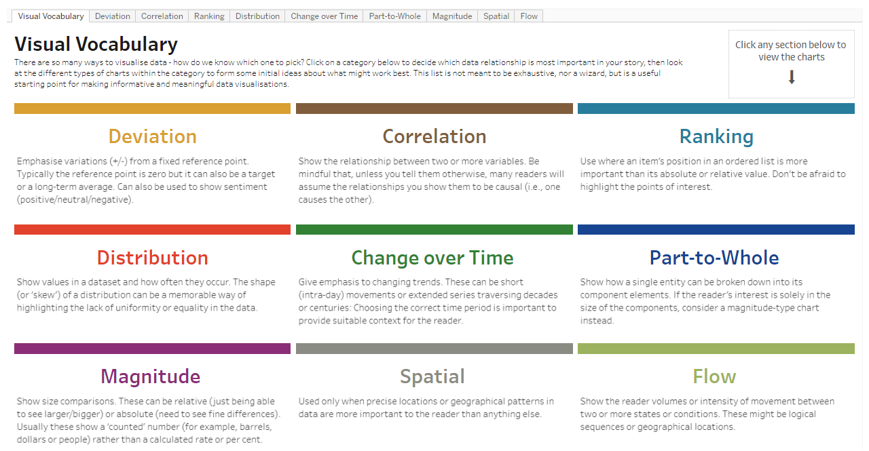
https://public.tableau.com/profile/andy.kriebel#!/vizhome/VisualVocabulary/VisualVocabulary

Slide 28
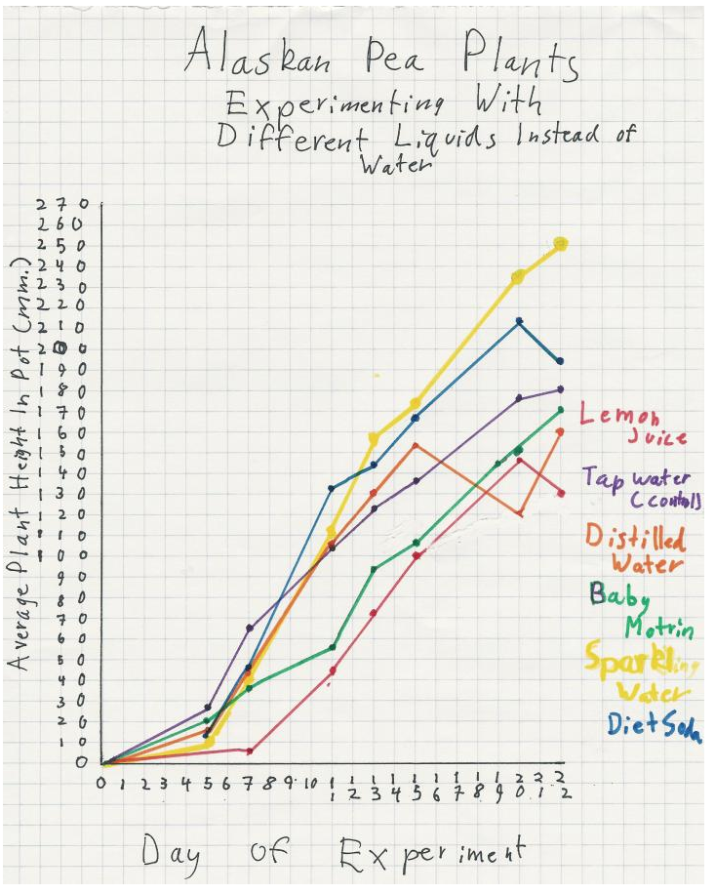
Charts communicate information visually

Slide 29
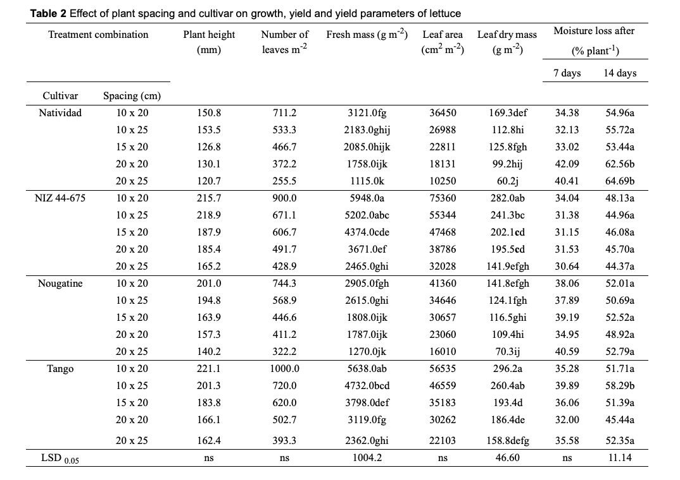

Slide 30
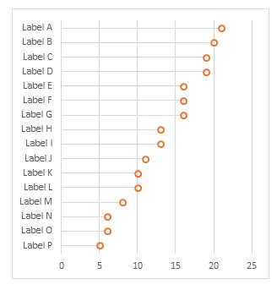
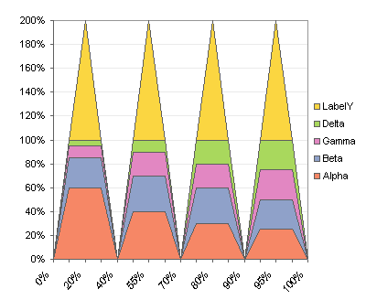
John Peltier
PeltierTech.com
The Chart Guru – excellent step-by-step directions for complicated charts.

Slide 31
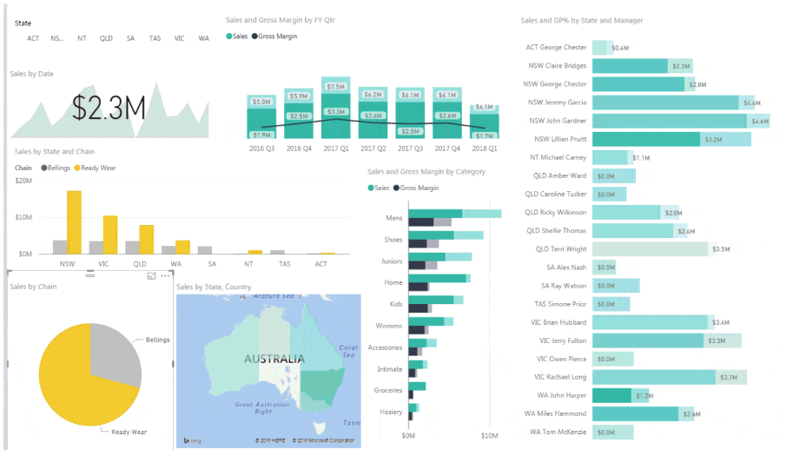
Mynda Treacy www.myonlinetraininghub.com
Dashboards and Power BI classes. Some webinars are free.

Slide 32
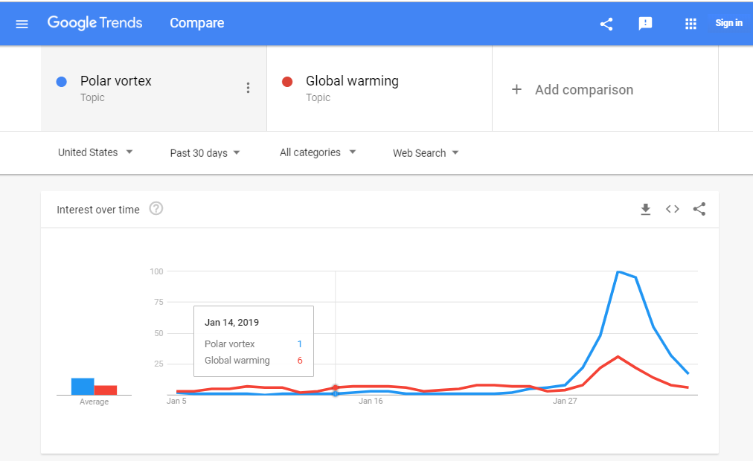
Google Trends:
Compare two search terms

Slide 33

Word Cloud

Slide 34
Thank You
Want a copy of this presentation?
Visit www.skokielibrary.info/handouts
where this presentation will be available
for four weeks.

