Slide 1
Beyond the Paywall: Reading Newspapers for Free
By Lynnanne Pearson
Adult Services Manager
January 24 2019
Notes:
Make the most of your library card, using it to read articles from newspapers that otherwise exist behind the paywall.
You no longer need to be frustrated with only getting a couple of free articles a month from great newspapers like The New York Times, The Washington Post, and the Wall Street Journal.

Slide 2
Today’s Agenda
Library PressReader
Chicago Tribune
The New York Times
The Wall Street Journal
The Washington Post
Notes:
The New York Times, The Washington Post, and the Wall Street Journal.

Slide 3
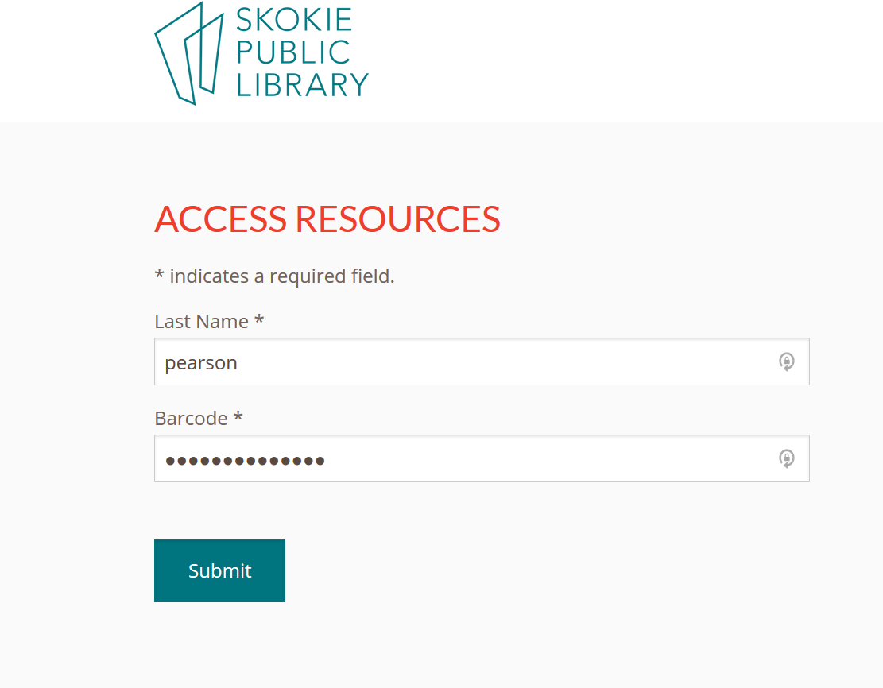
For home access for most of these products, you will first enter your last name and barcode on this landing page.

Slide 4
Library PressReader

Slide 5
Newspapers from Library PressReader
Over 7,000 publications from over 120 countries in over 60 languages.
Local newspapers
  the Chicago Tribune and the Chicago Sun-Times
Newspapers from around the country
  the Washington Post and the NY Post
Newspapers from around the world
  The Daily Mail and the Times of India
Most publications have 90 days of issues archived.
  The Chicago Tribune only has issues from the current week.

Slide 6
Newspapers from Library PressReader
You can select favorite publications and save materials to your devices.
Translates to and from many languages
Full images
Articles can be read to users
Ability to download or print

Slide 7
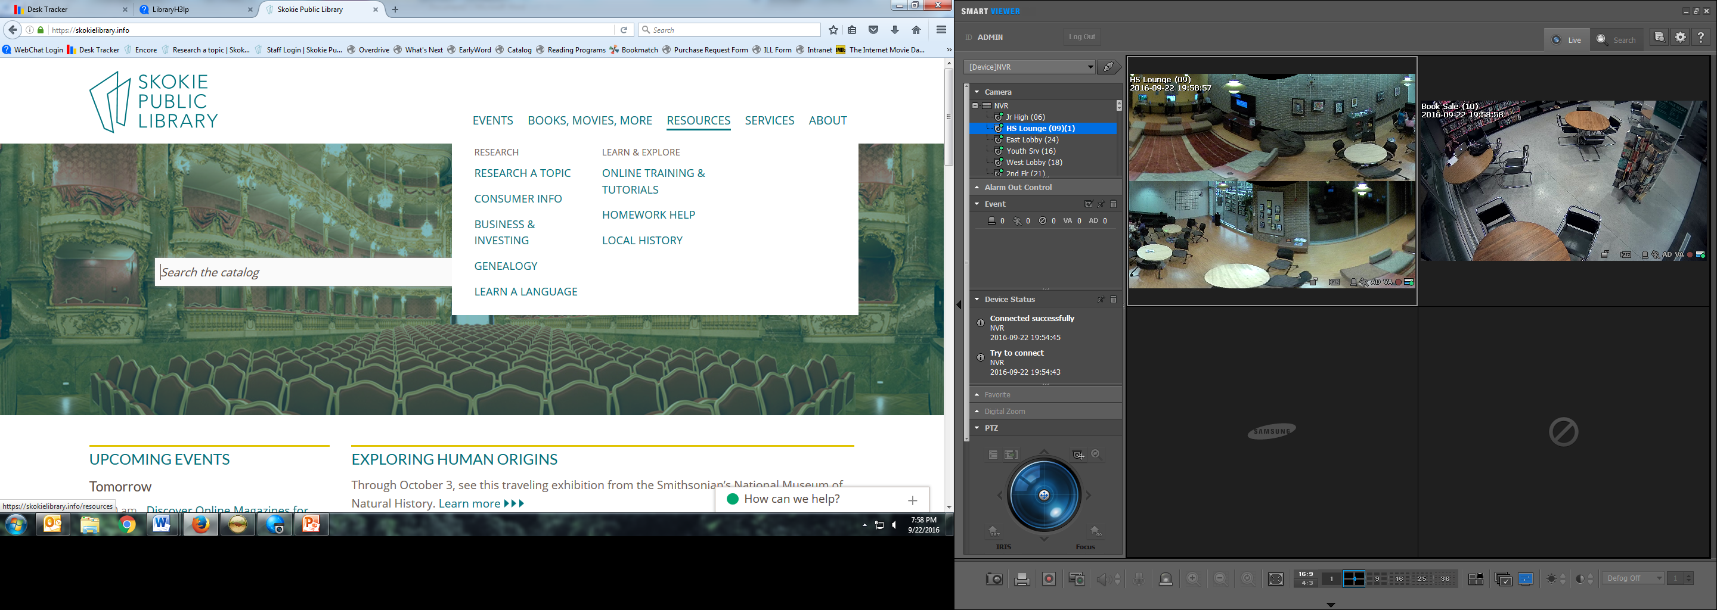

Slide 8
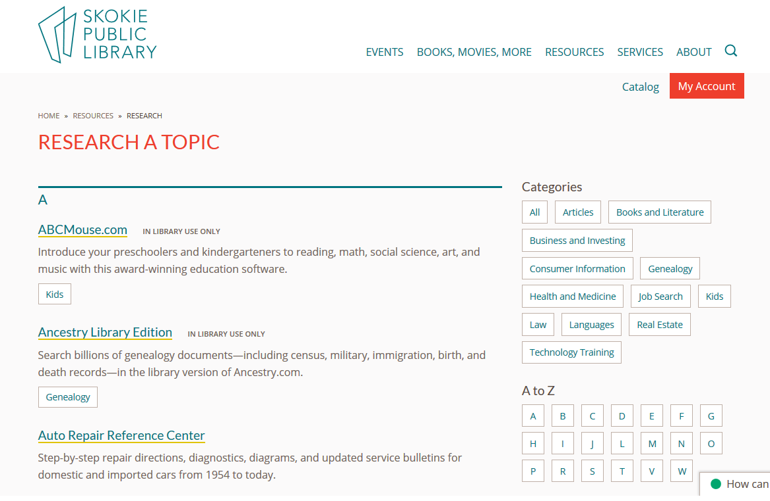


Slide 9
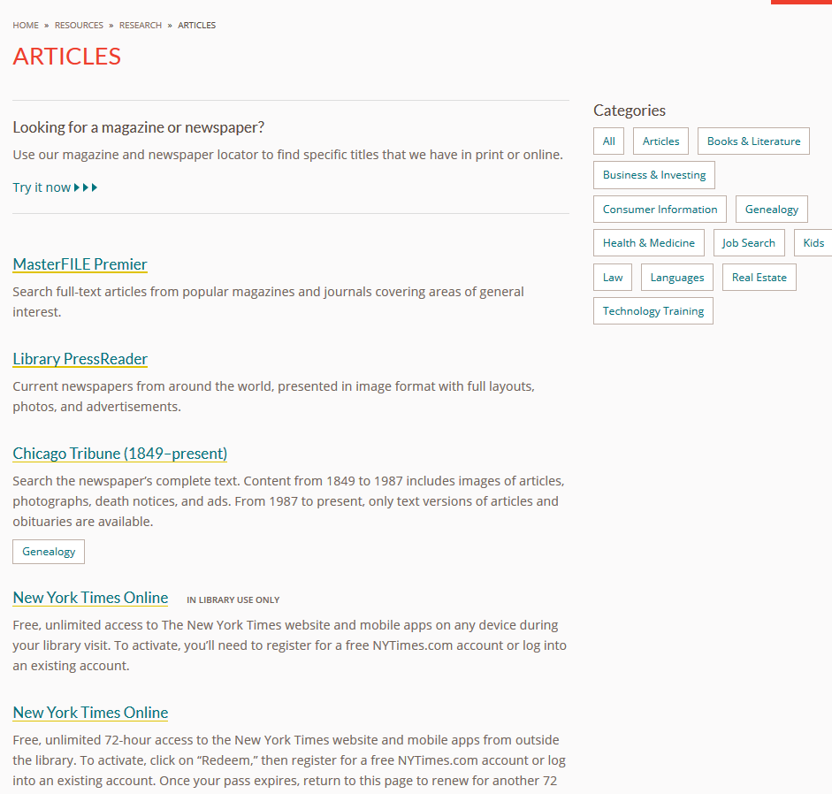

Slide 10
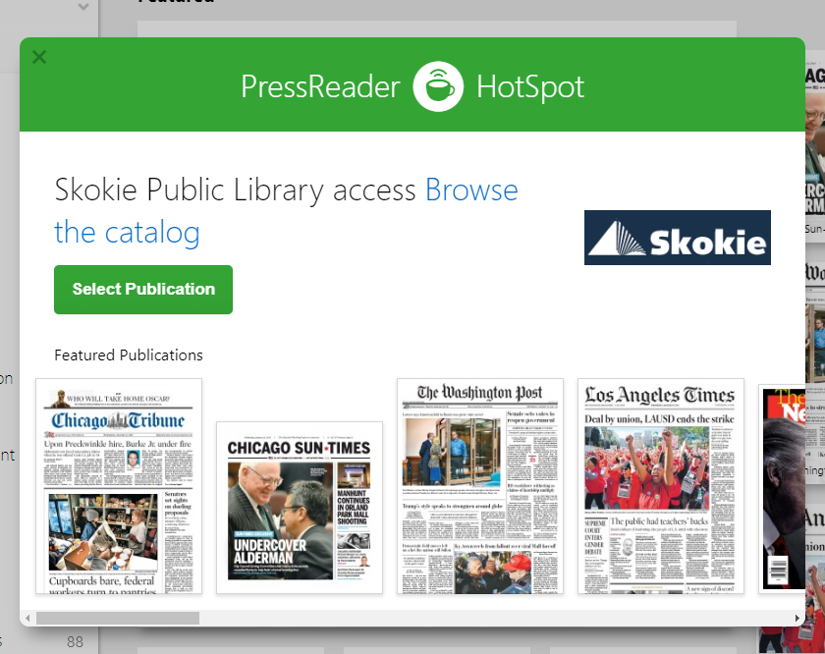

Slide 11
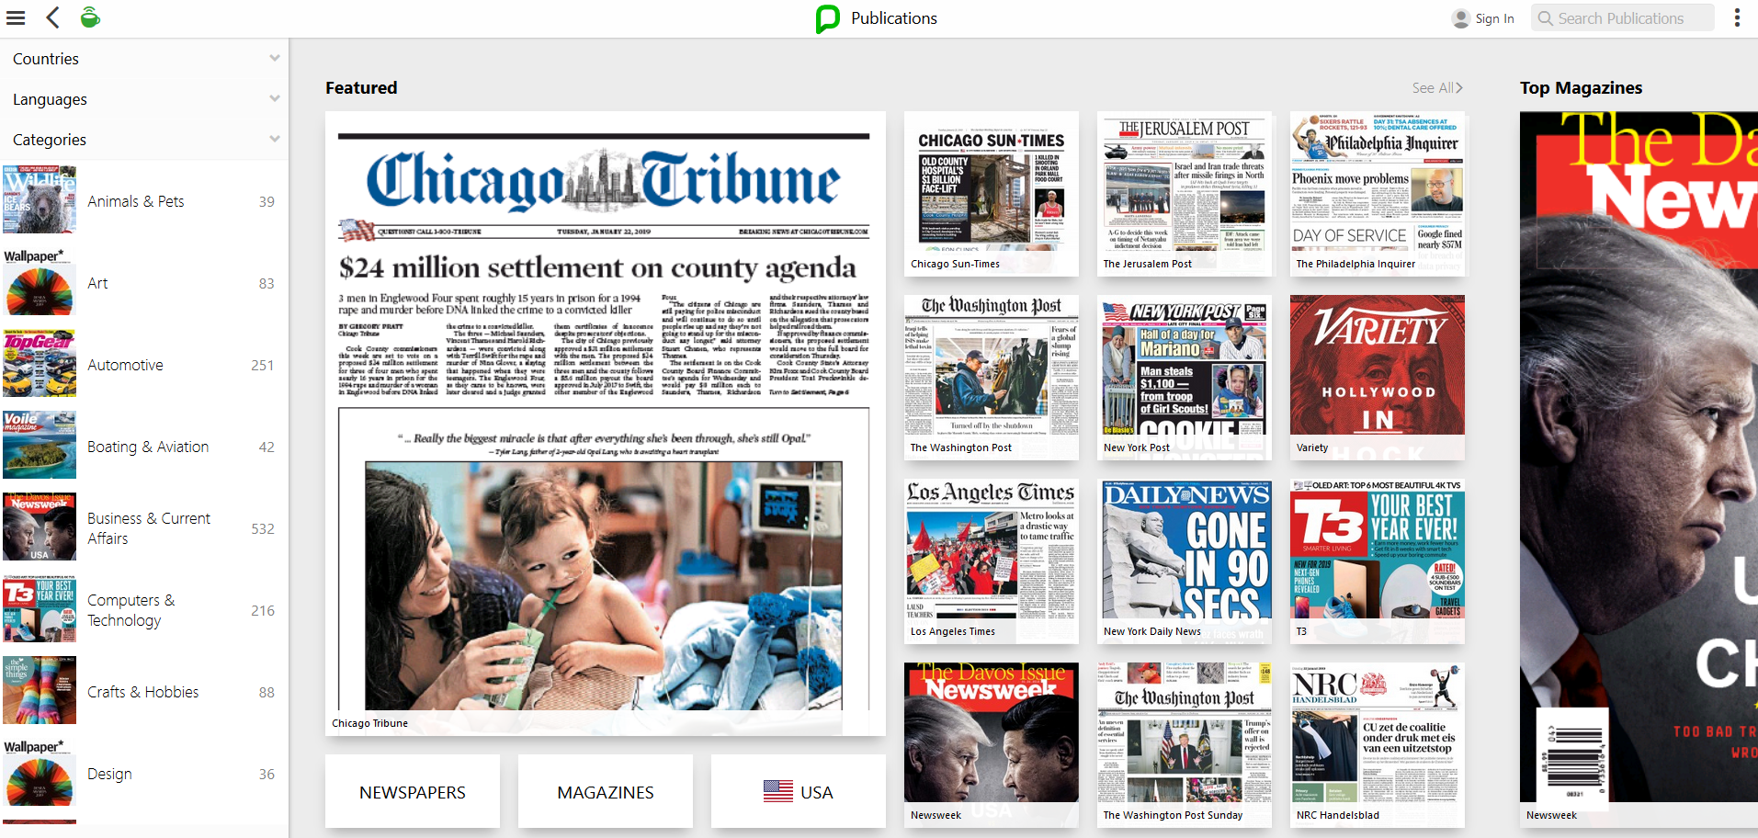

Slide 12
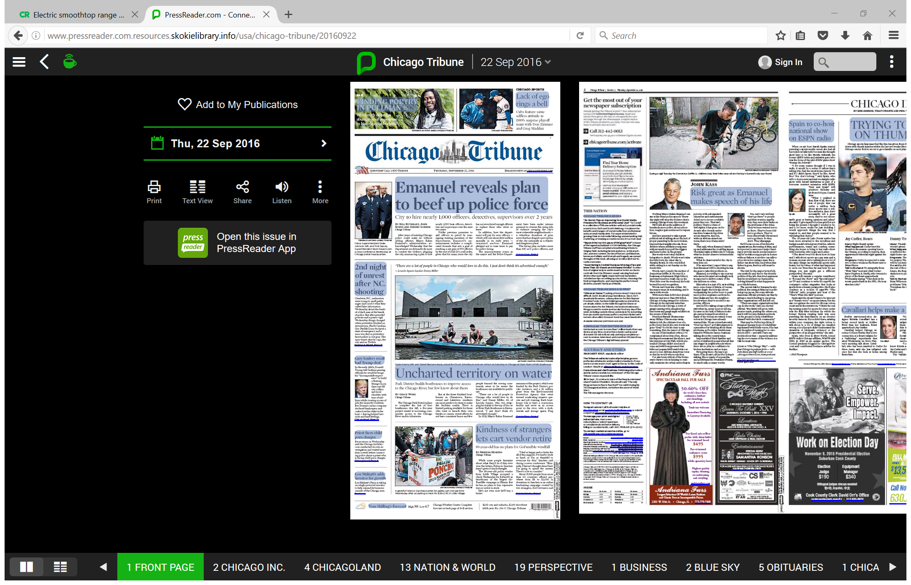
Click on an article to read it

Slide 13
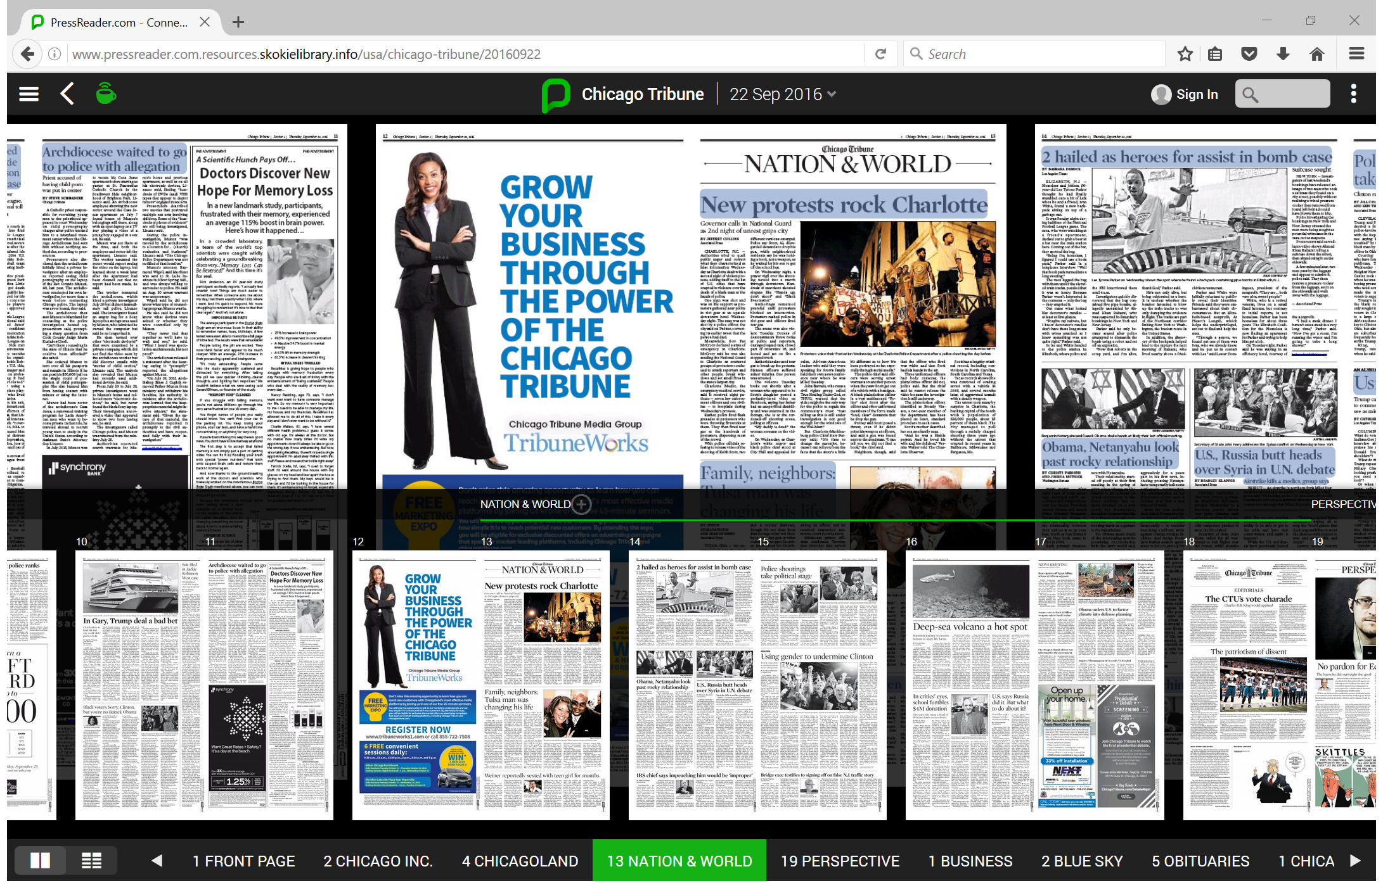
Click on the numbered headings on the bottom to get to that section of the paper

Slide 14
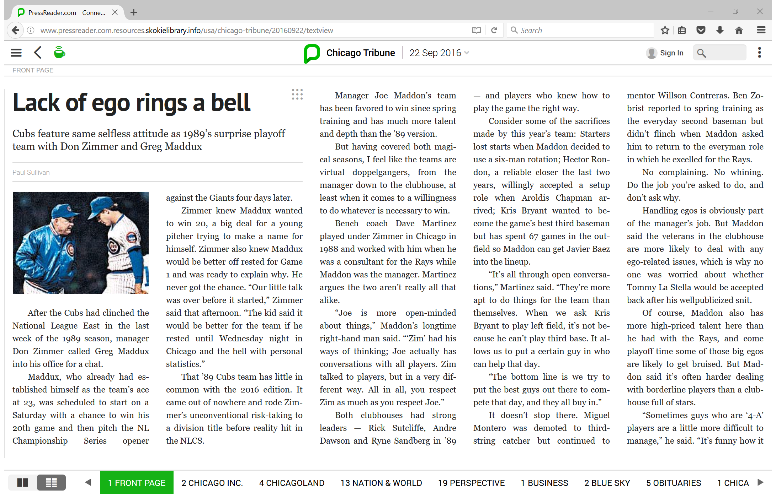

Slide 15
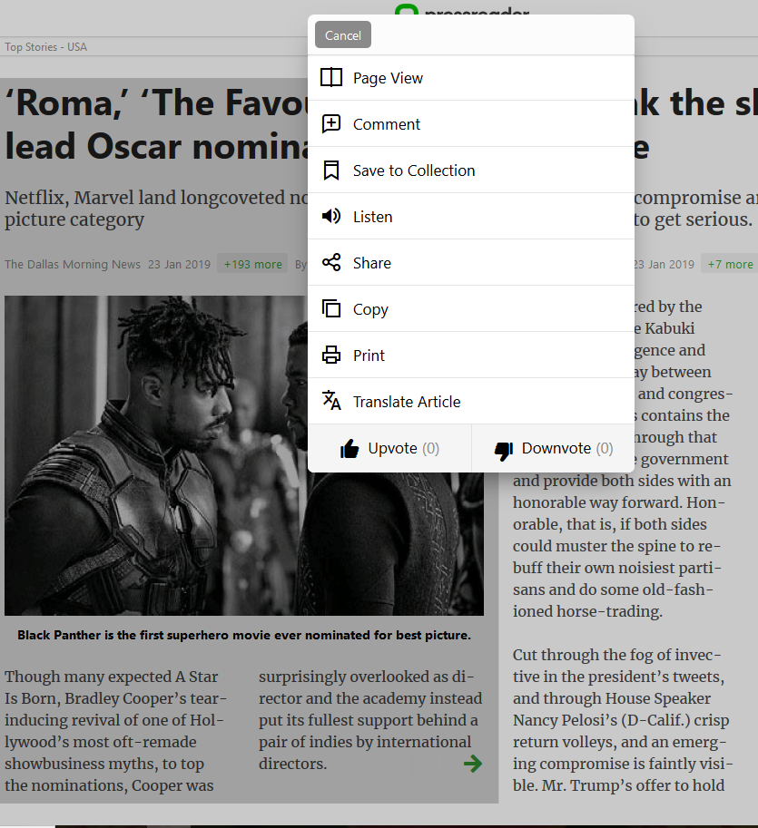
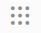
In every story, click on the dots
to get the menu.
Notes:
Share, print, save, copy, listen or translate the article.

Slide 16
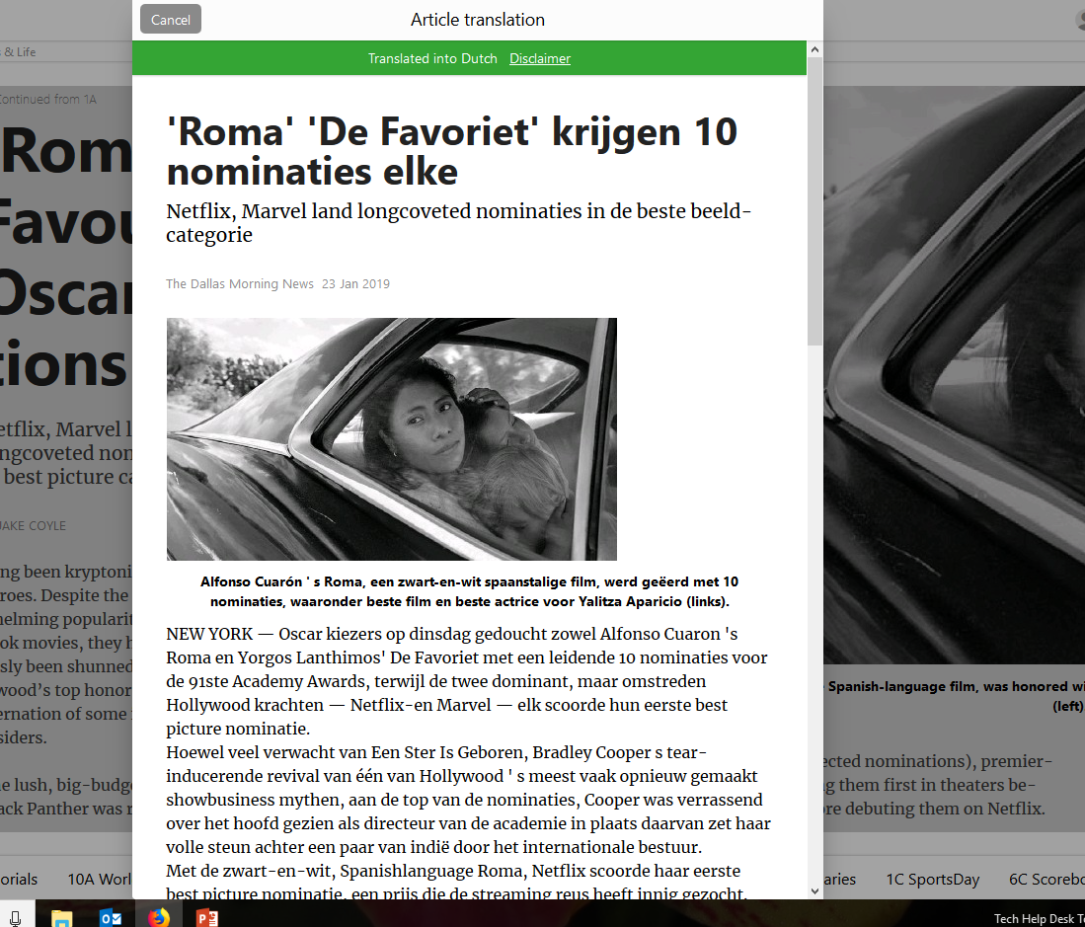
Translate to another language
An article translated into Dutch. Just one of the many languages you can pick to translate an article into.

Slide 17
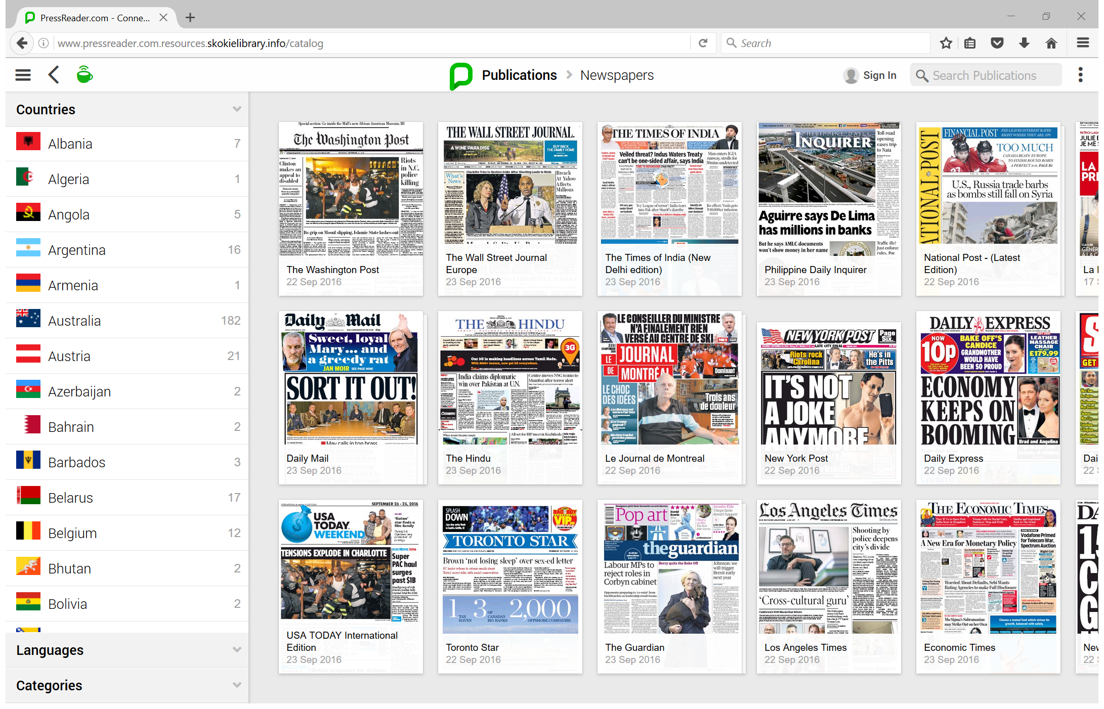
Choose the country to view the newspapers from that country.

Slide 18
Magazines from Library PressReader

Slide 19
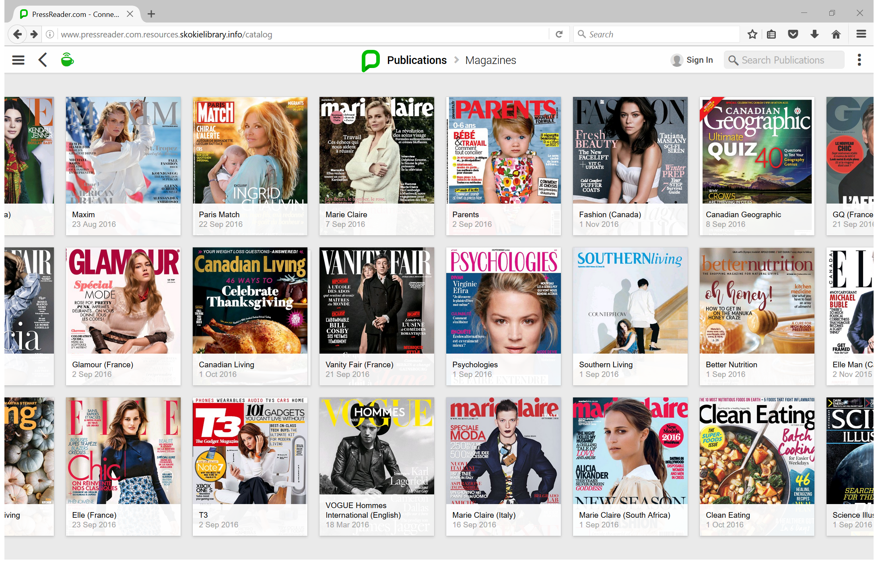

Slide 20
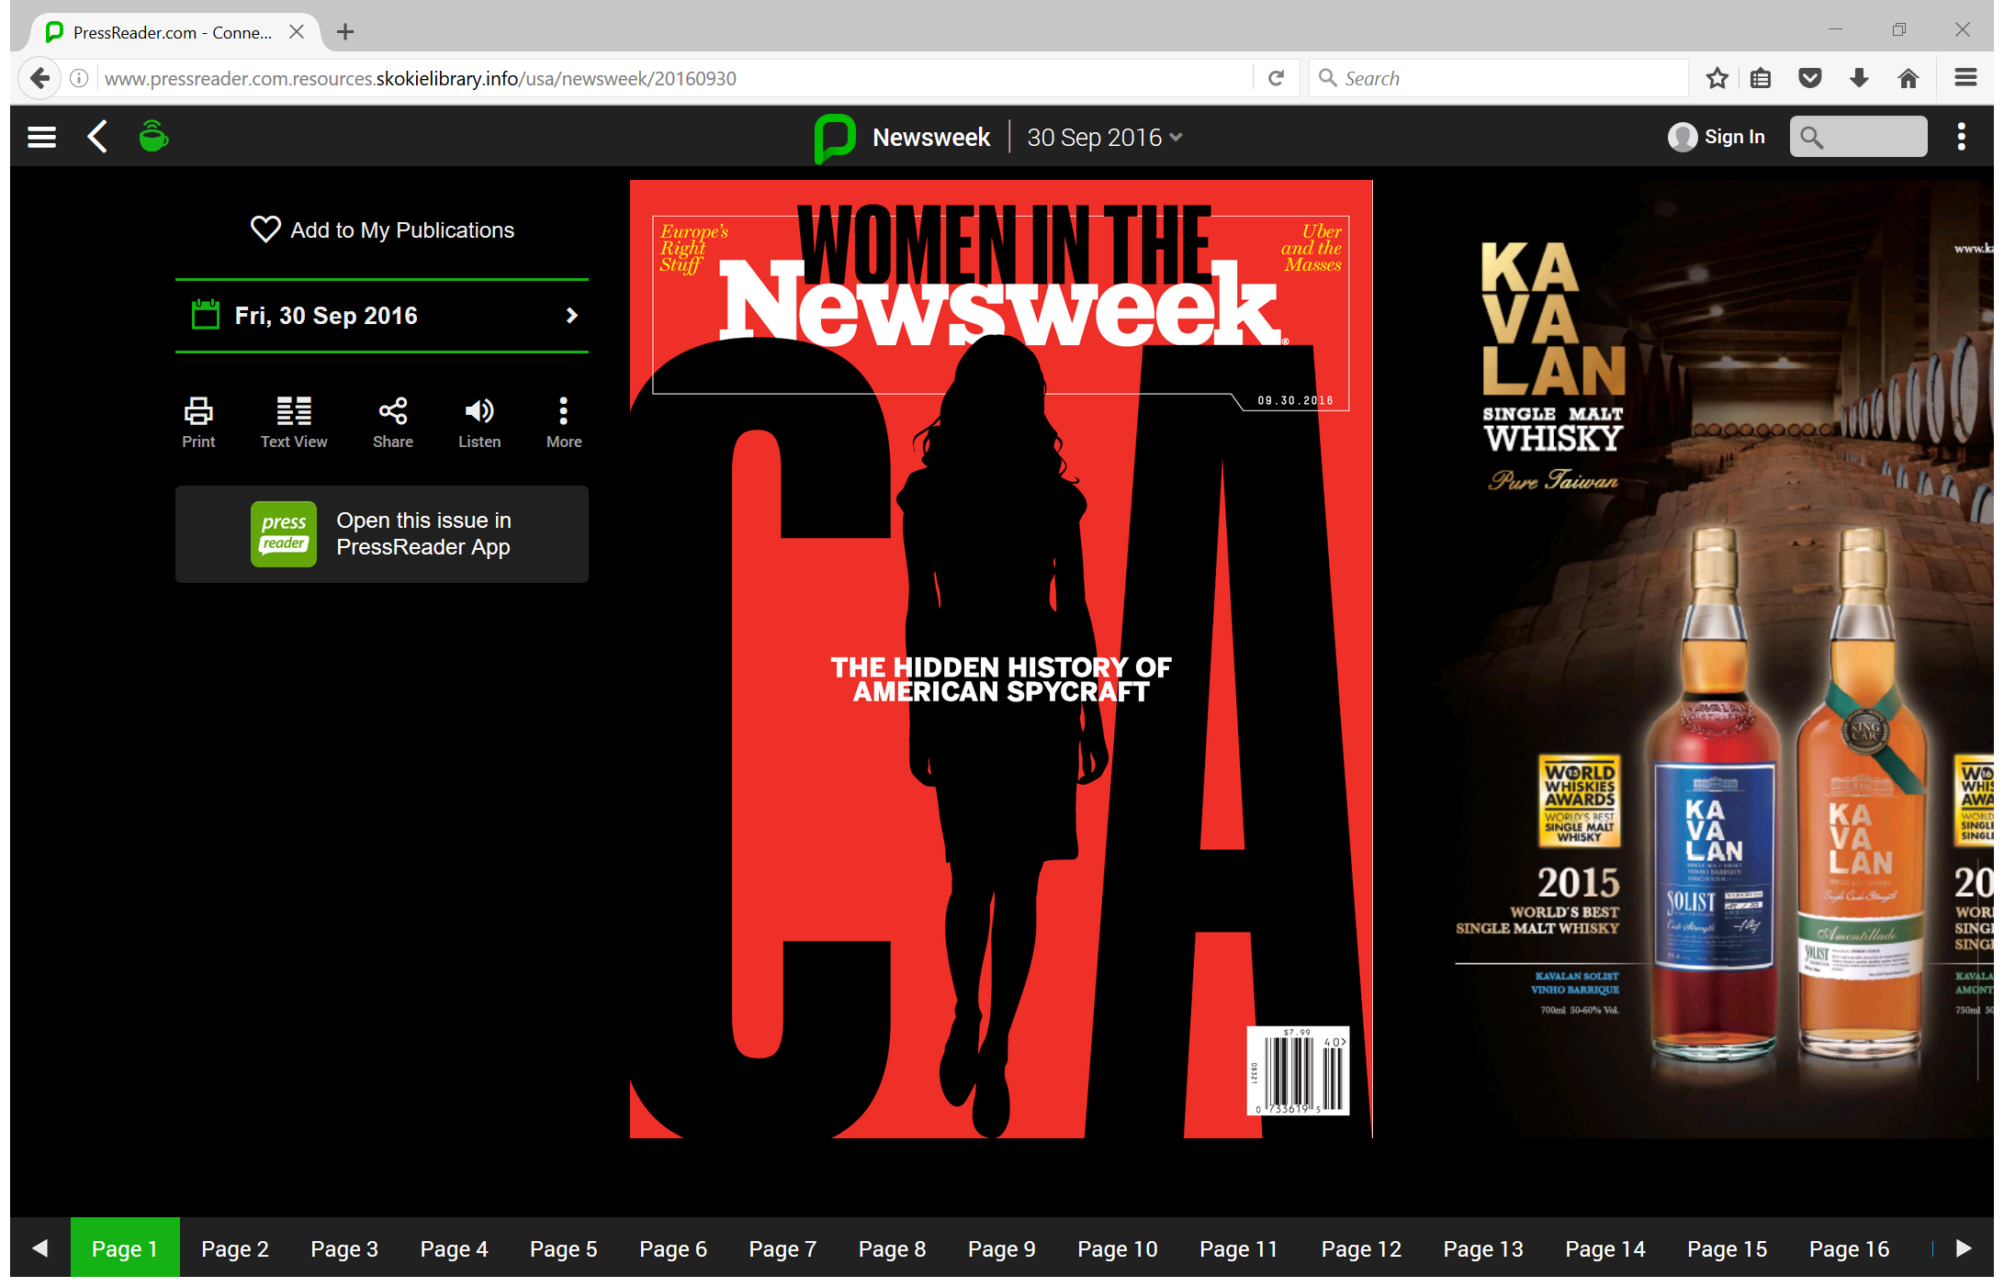

Slide 21
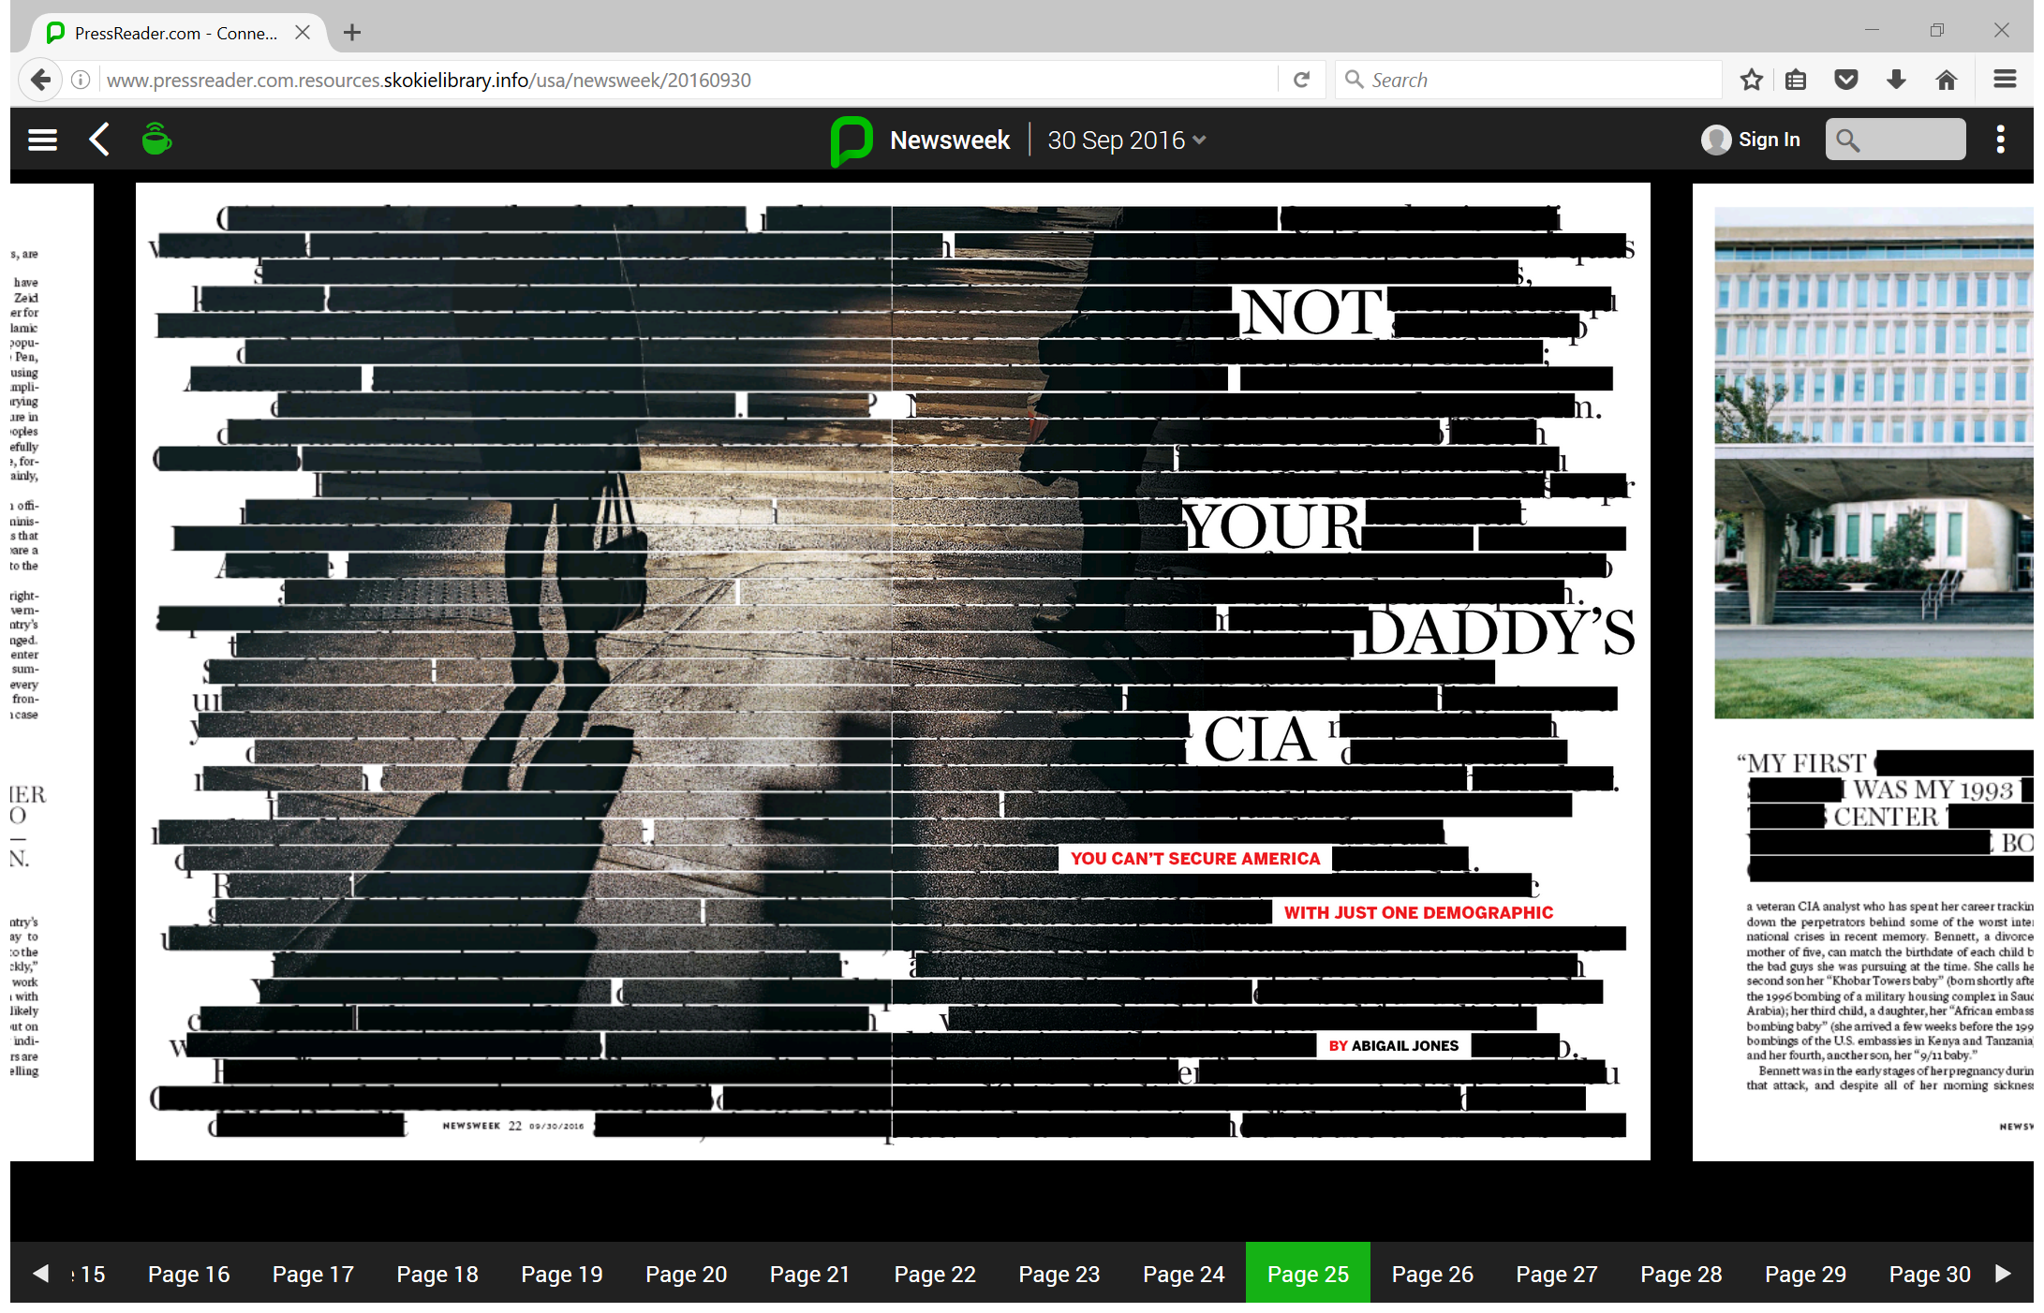

Slide 22
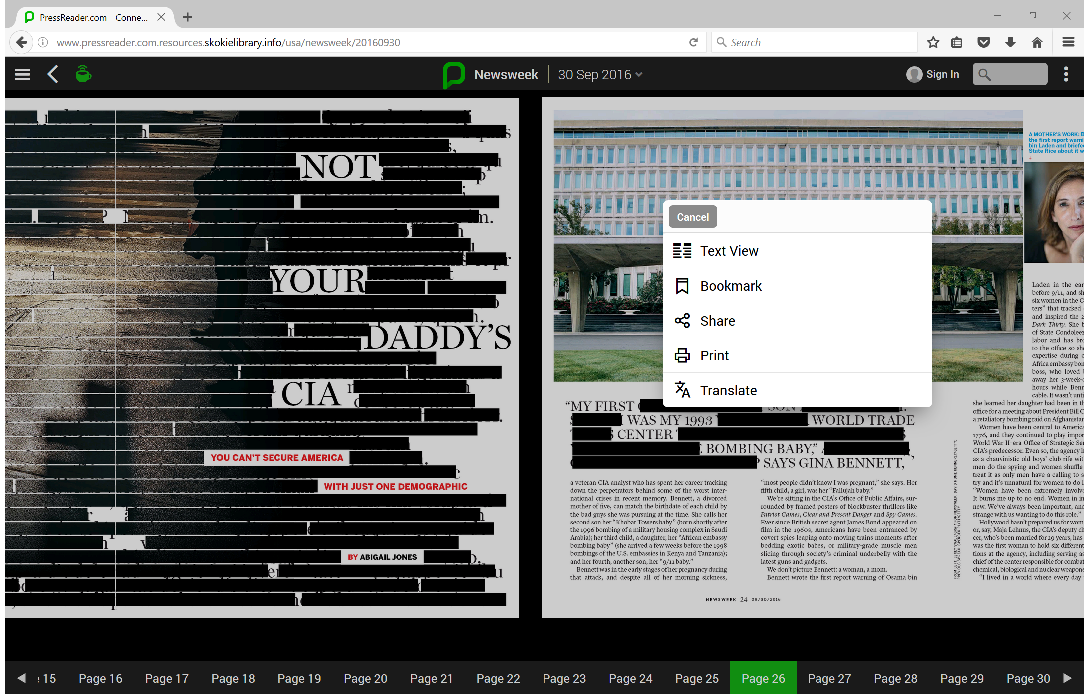
Right click for menu

Slide 23

PressReader app
Available for both Android and Apple devices
Need to set up an account through the library’s PressReader site and then use that account to log into the app.
Same functionality as the website.

Slide 24
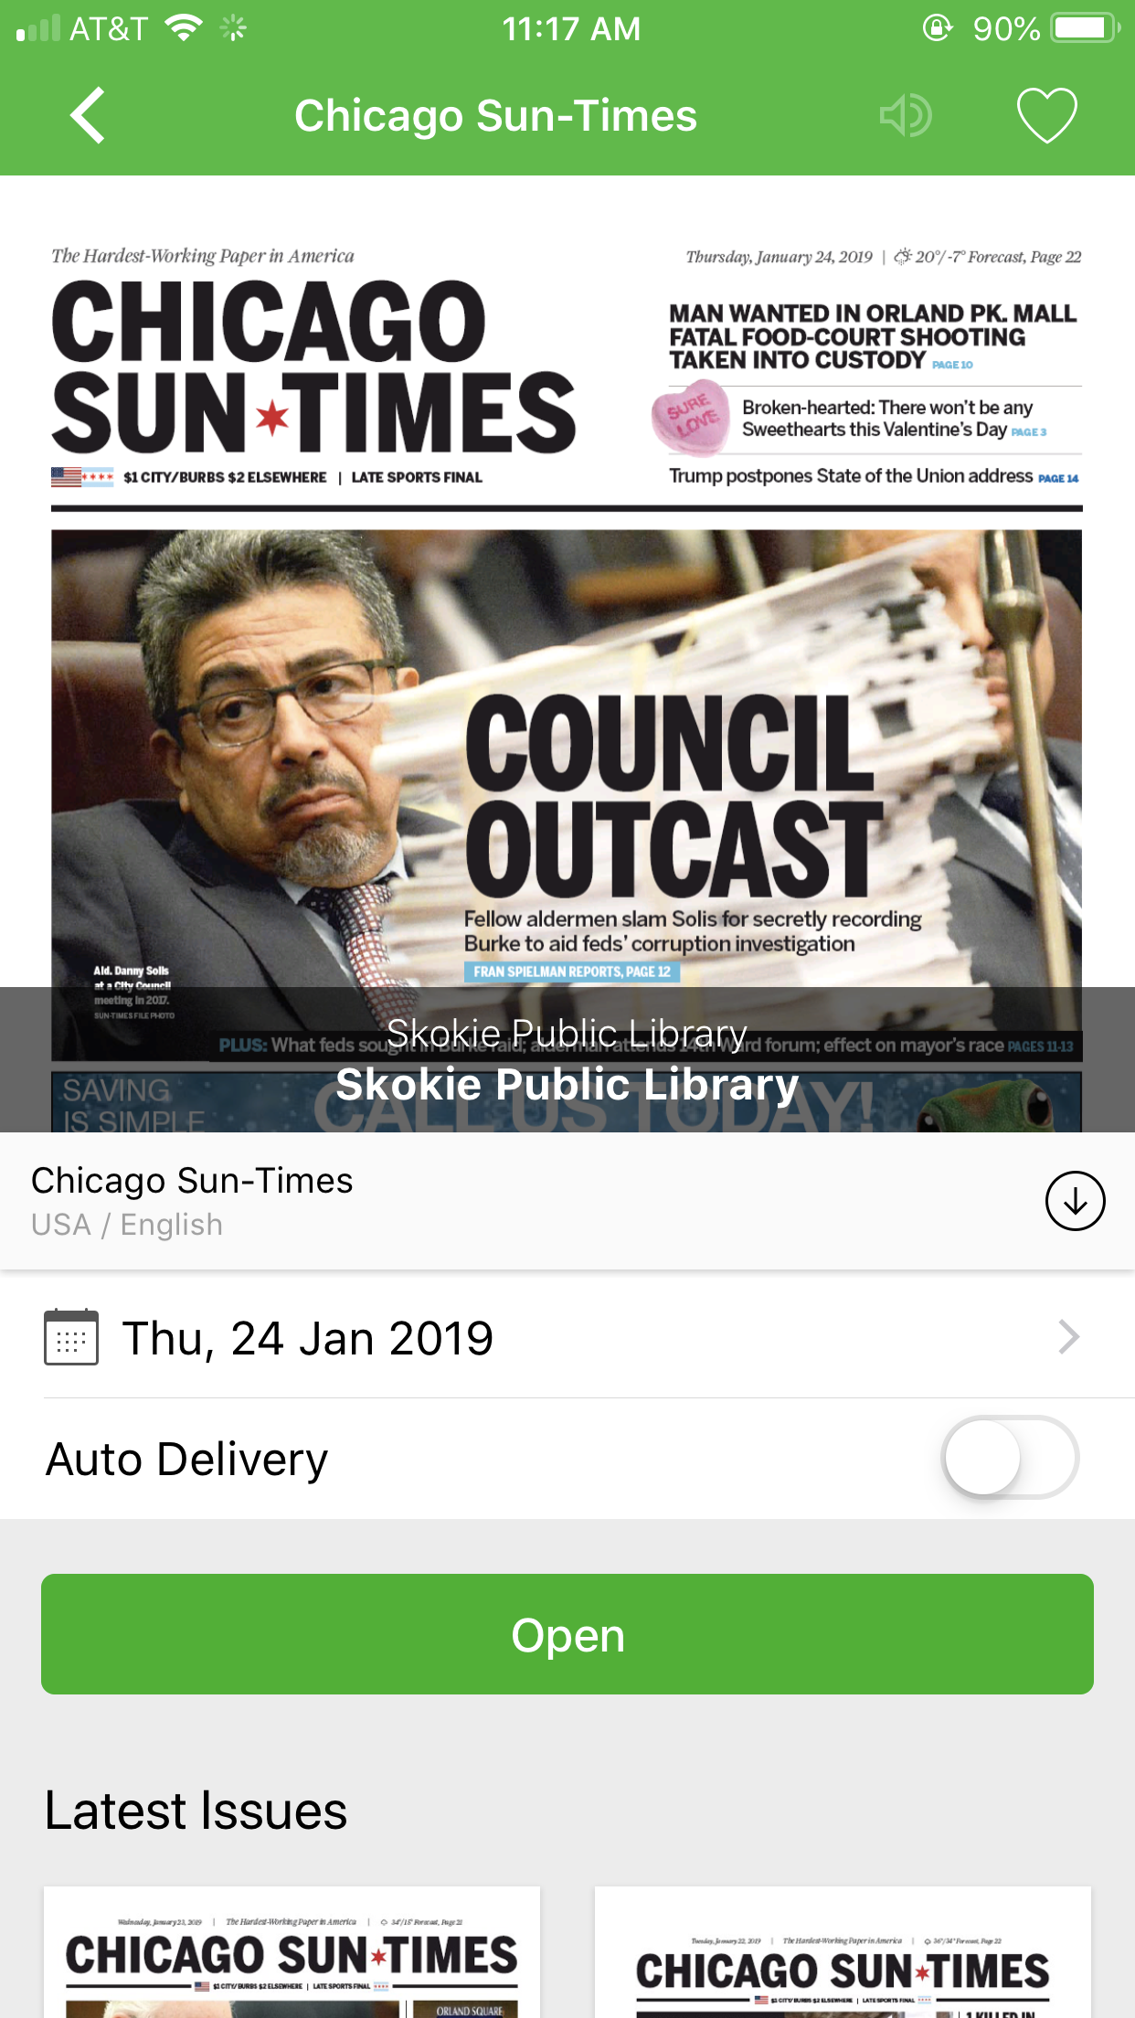
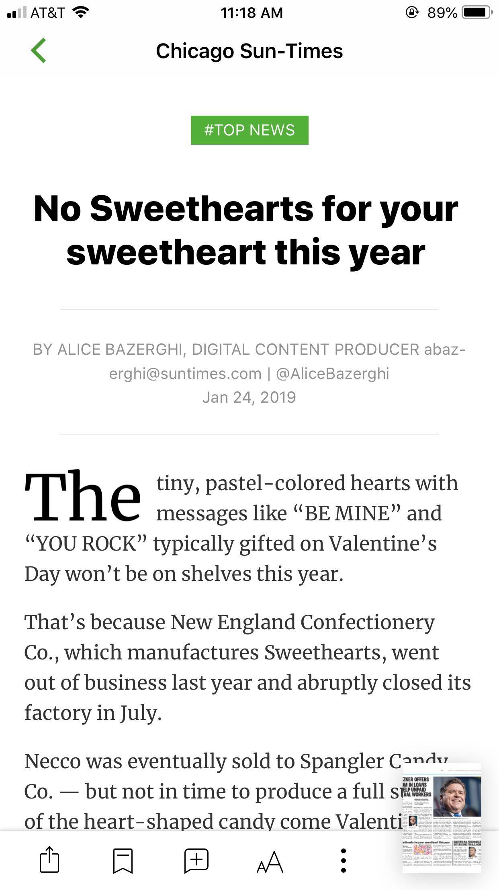
App experience

Slide 25
Chicago Tribune

Slide 26
Chicago Tribune via Proquest
Access to articles more than this week.
Complete text and content from 1849 to 1987.
  includes images of articles, photographs, death notices, and ads.
Only text versions of articles and obituaries are available from 1987 to present.

Slide 29
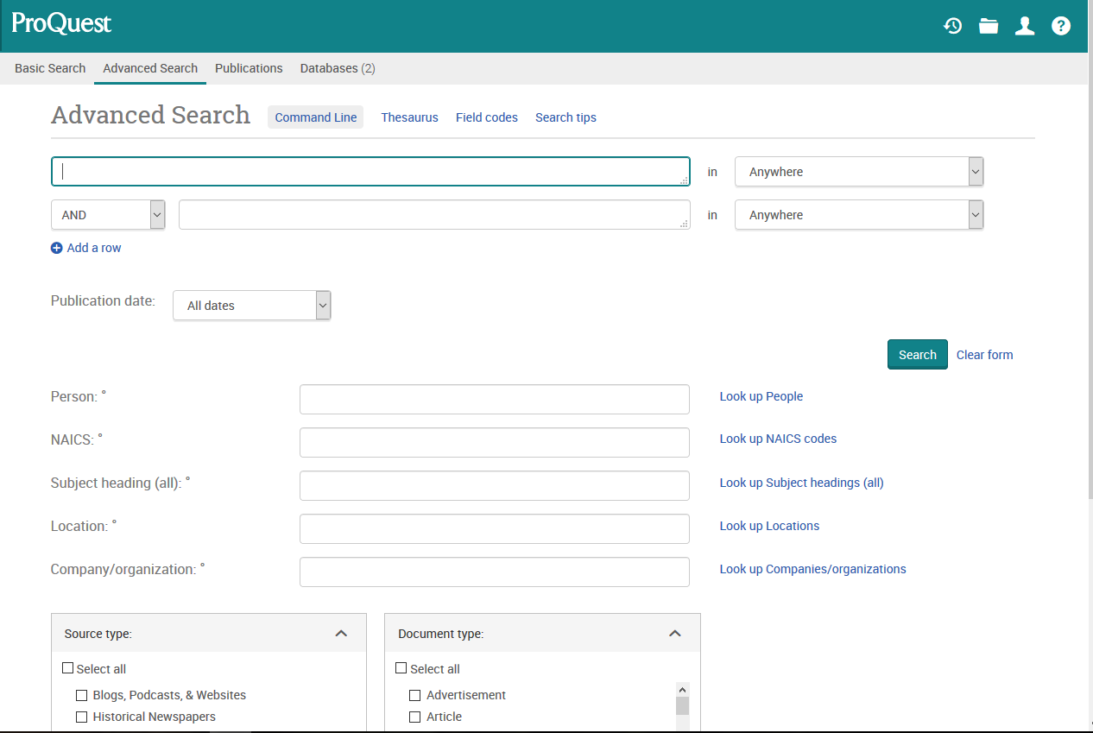

Slide 30
Search by
Combining search terms
Article subject’s name
Article author’s name
Company name
NAICS code
Notes:
North American Industry Classification System codes classify organizations by industry. You can use them to find documents related to a particular industry.

Slide 31
Narrow your search
Change the date range
Add more search terms
Select a specific section of the paper such as:
  Advertisement
  Birth Notice
  Commentary
  Editorials
  Feature
  Front Matter
  Front Page/Cover Story
  Image/Photograph
  Marriage Announcement
  Obituary

Slide 32
Example: I searched for Sox and disco

Slide 33
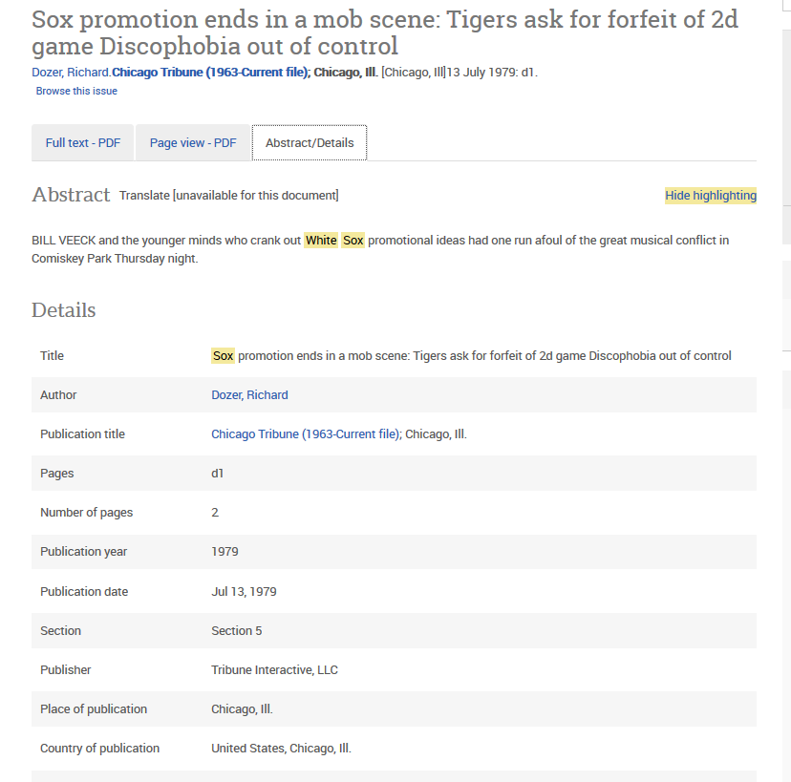

Slide 34
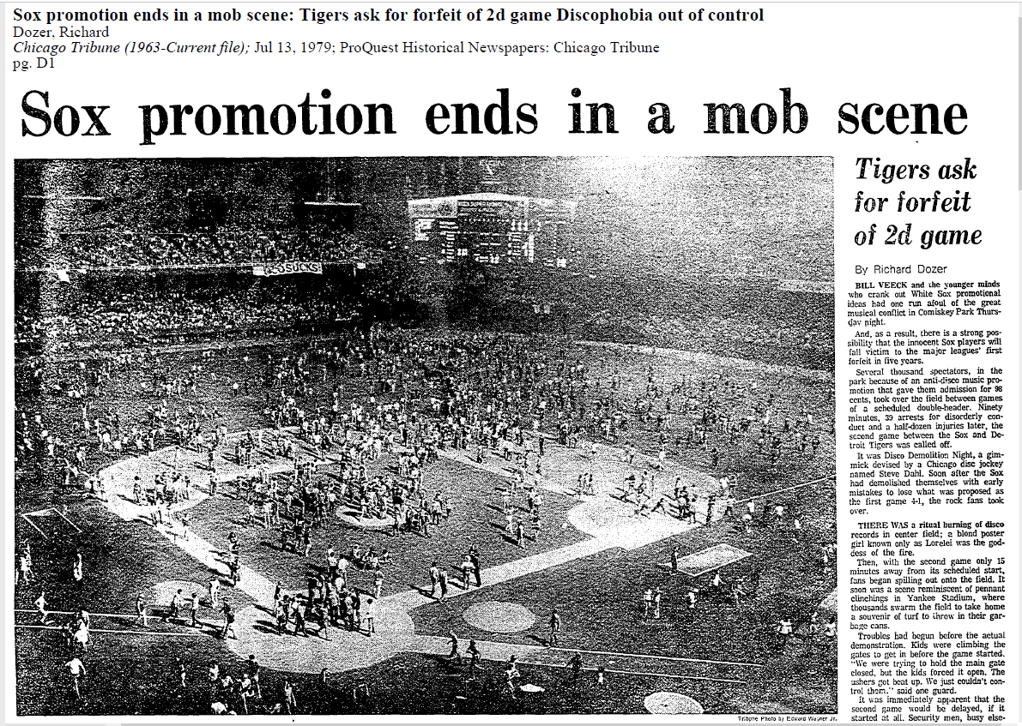
Notes:
Dozer, R. (1979, Jul 13). Sox promotion ends in a mob scene. Chicago Tribune (1963-Current File) Retrieved from https://search.proquest.com/docview/170102939?accountid=3671

Slide 35
I then searched for Cubs and World Series

Slide 36
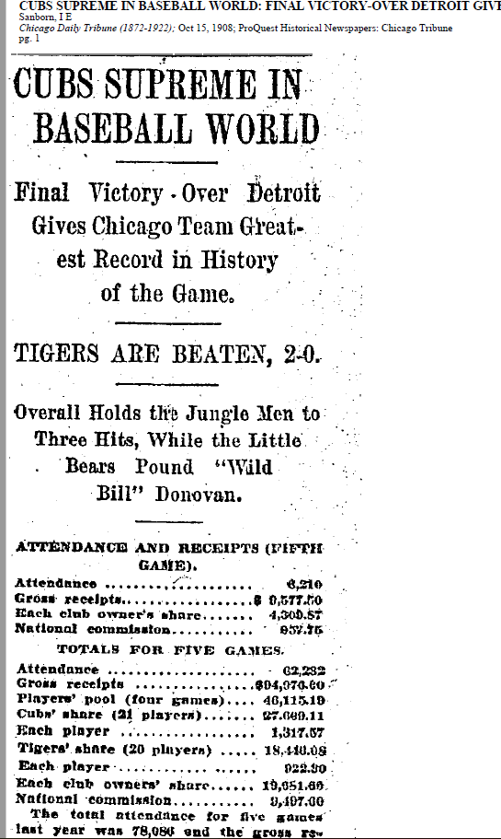
Cubs world series
1908

Slide 37
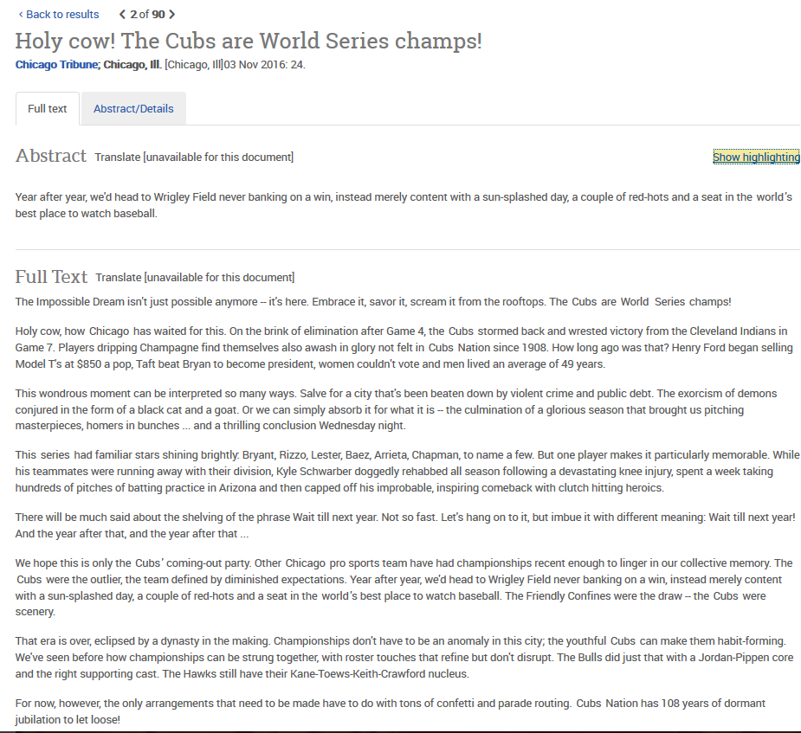
Cubs World Series 2016

Slide 38
New York Times

Slide 39
In Library Access

Slide 40
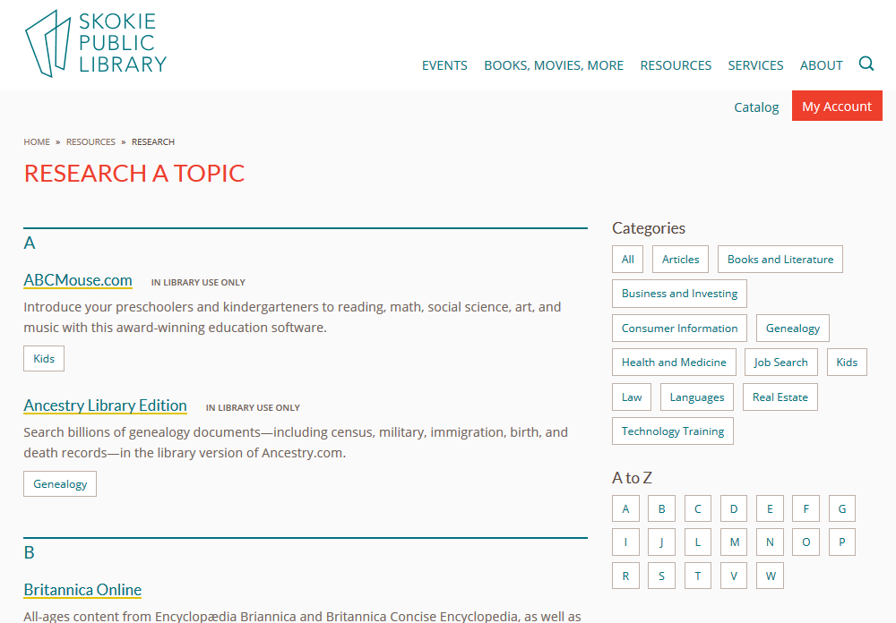
https://skokielibrary.info/resources/research/

Slide 41
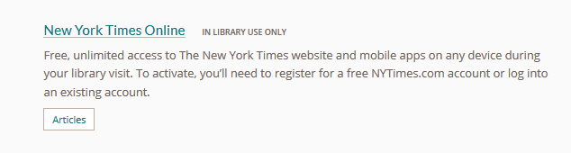

Slide 42
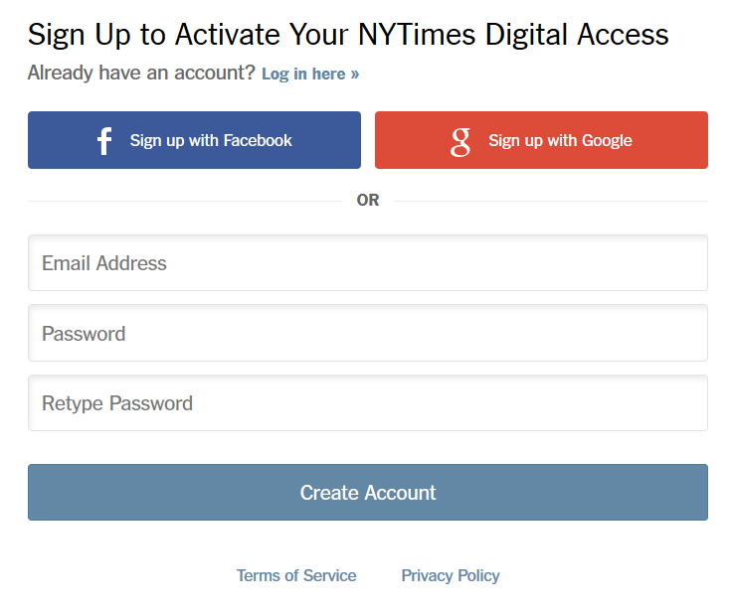
Already Registered on NYTimes.com? Click here to log in
Need to Register? Enter your email address and select a password here. Click Create Account.

Slide 43
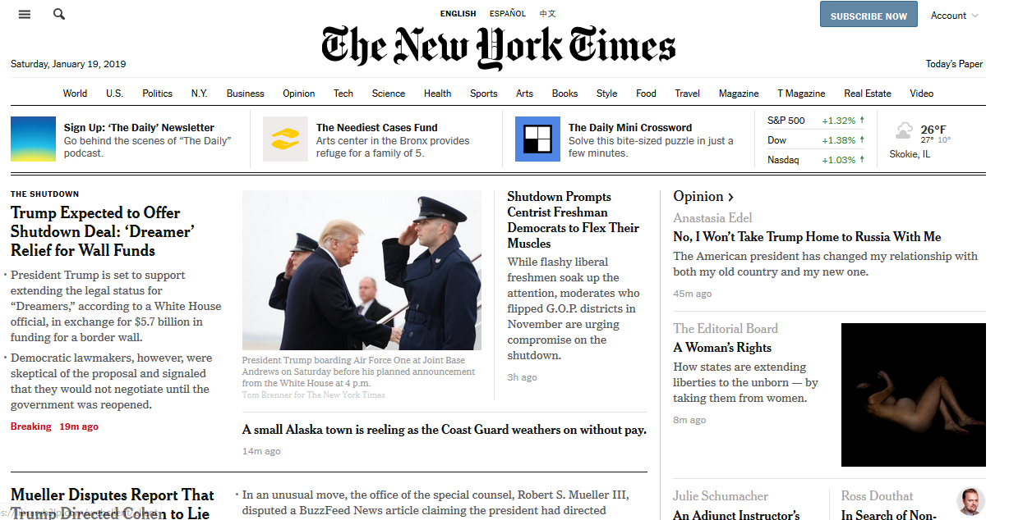
All the news of the day

Slide 44
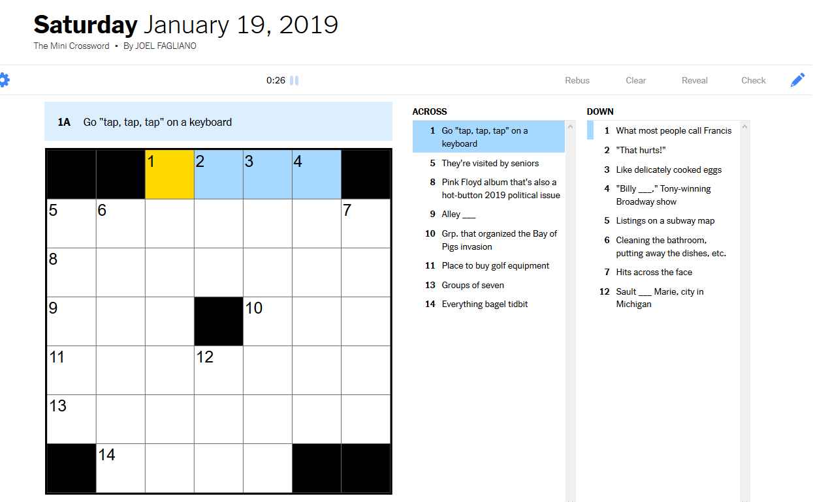
You can even do the crossword!

Slide 45
Home access

Slide 46
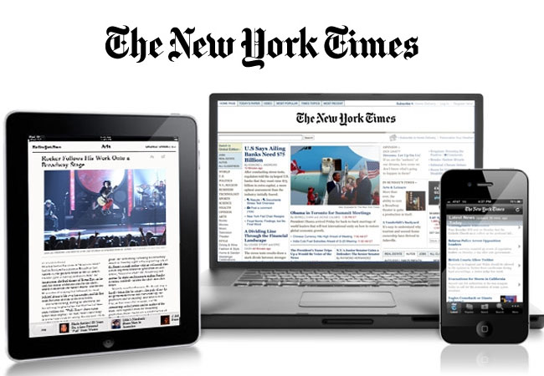
One Code Redemption Process

Slide 47
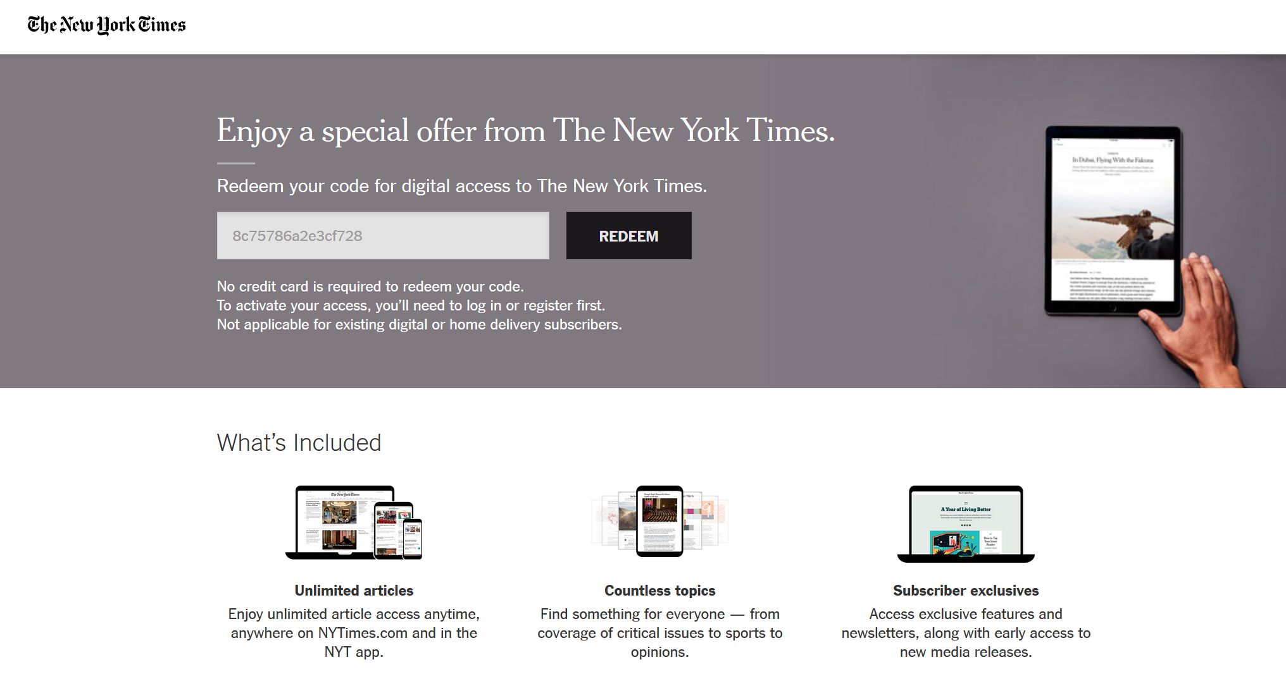
Once you click on the link on library’s website, you are directed to this page. Click on redeem for home access to the NYTimes

Slide 48
Already Registered on NYTimes.com? Click here to log in
Need to Register? Enter your email address and select a password here. Click Create Account.

Slide 49
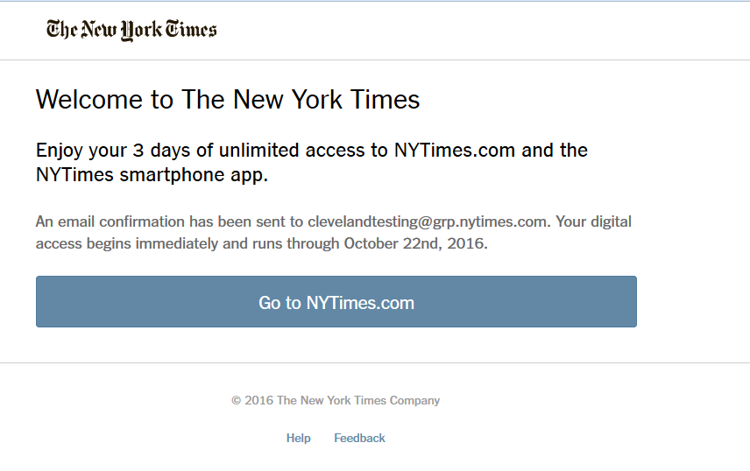
Once you have logged in or Registered, you will be presented with the confirmation page which will provide the expiration date.
You cannot redeem a subsequent code until the current one expires

Slide 50
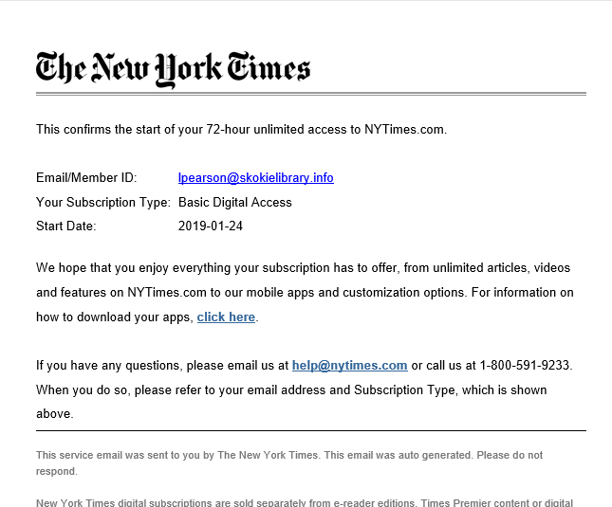
Email you receive

Slide 51
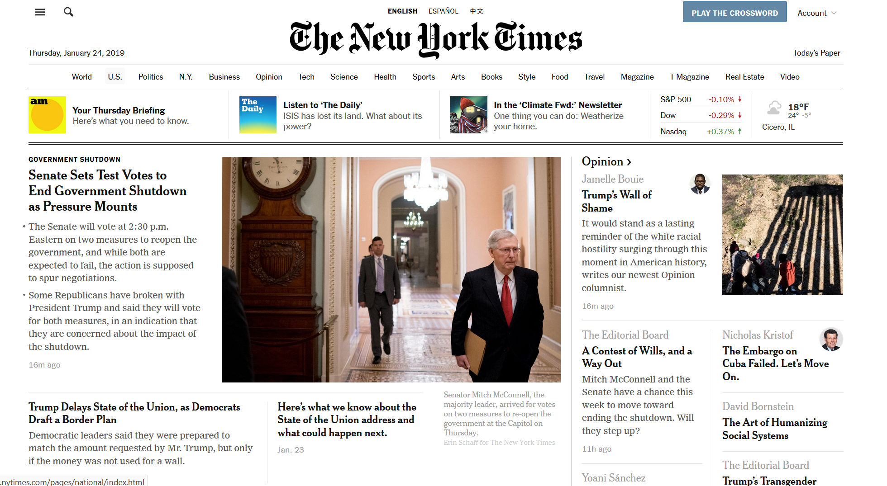
All the news of the day

Slide 52
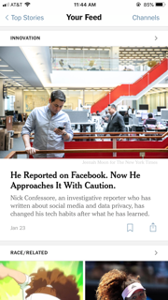
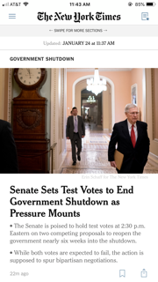
New York Times app
Available for both Apple and Android devices.
The same log in that you created for desktop access, you can use to log into the app
You can customize your news feed with the topics you are interested in.

Slide 53
Wall Street Journal

Slide 54
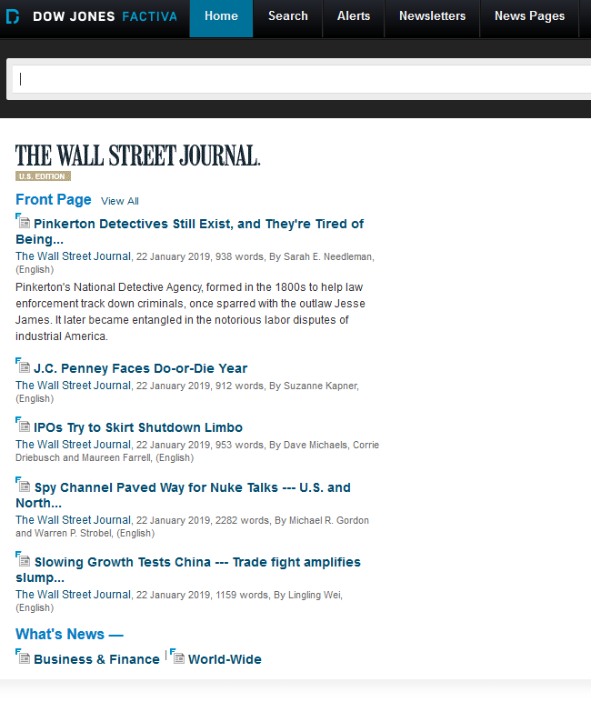
Factiva
Access to Full text articles

Slide 55
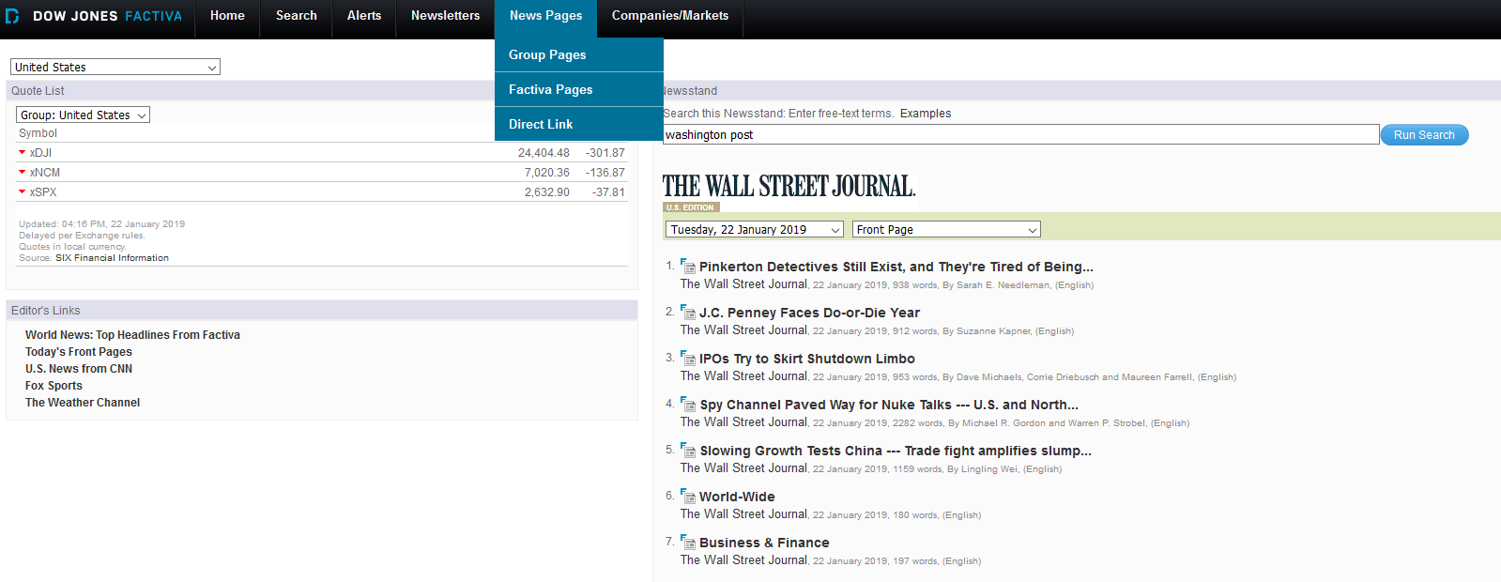
News Pages, then click on Factiva Pages

Slide 56

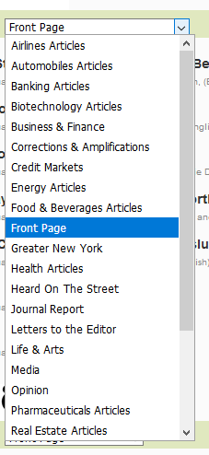
Navigating Factiva
Select the day you want from the dropped down menu
Select the section of the newspaper you want
Scroll through the articles and then click on the articles to read it

Slide 57
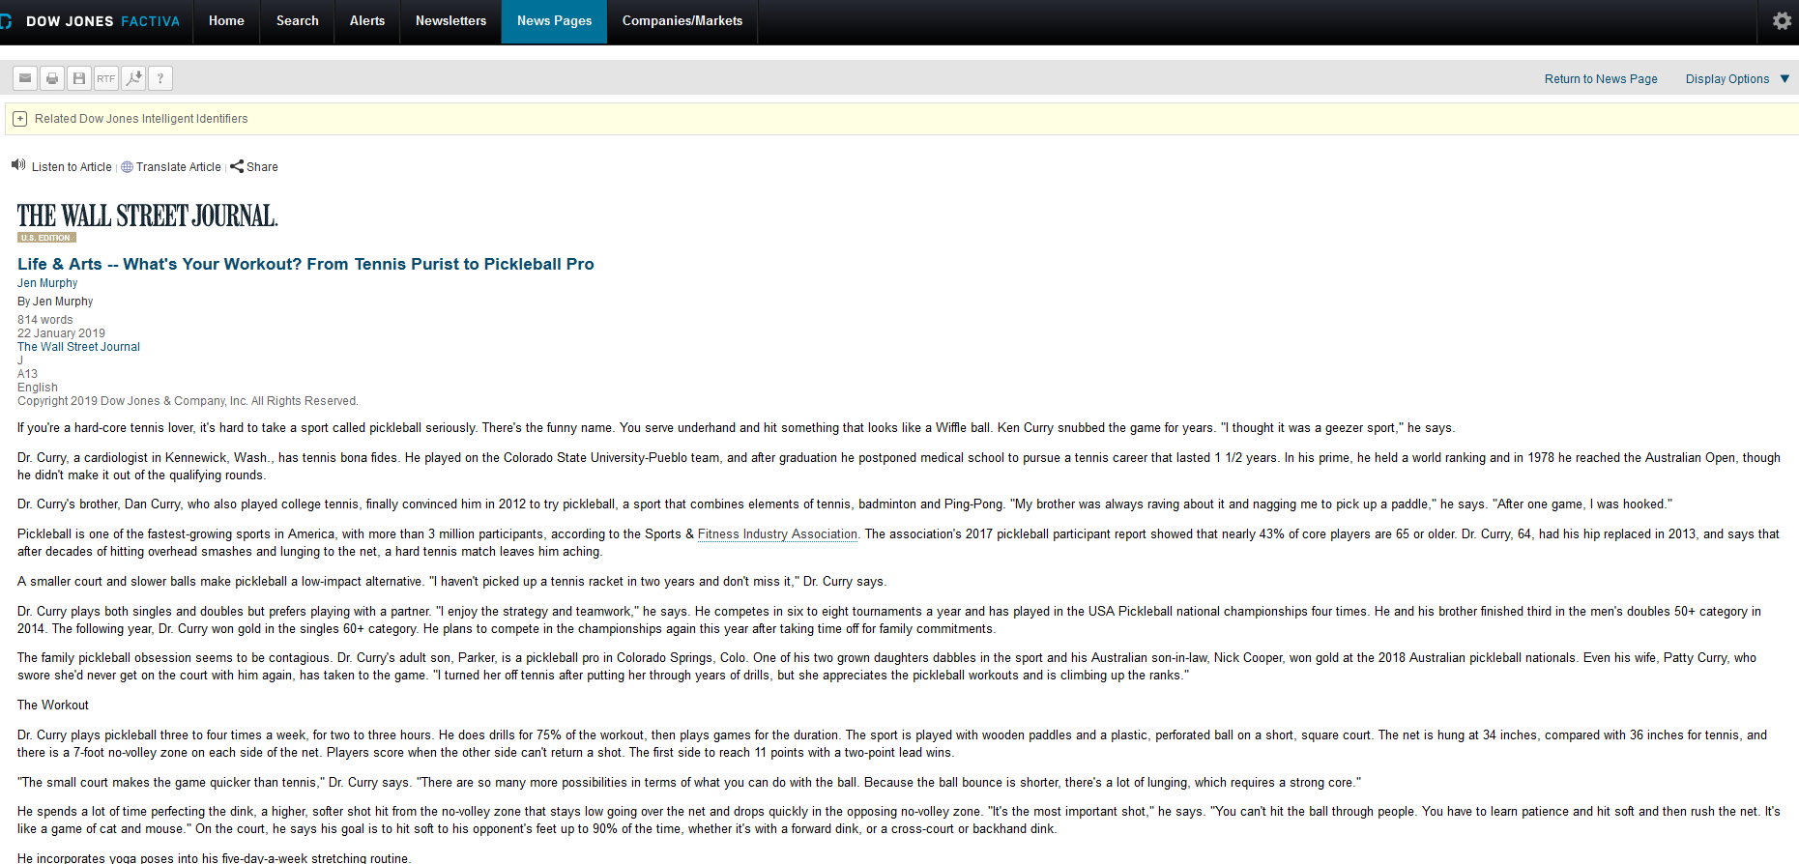
Click on these boxes to email, print or save the article

Slide 58
Washington Post

Slide 59
Through PressReader
Current issue plus 90 days in the past

Slide 62
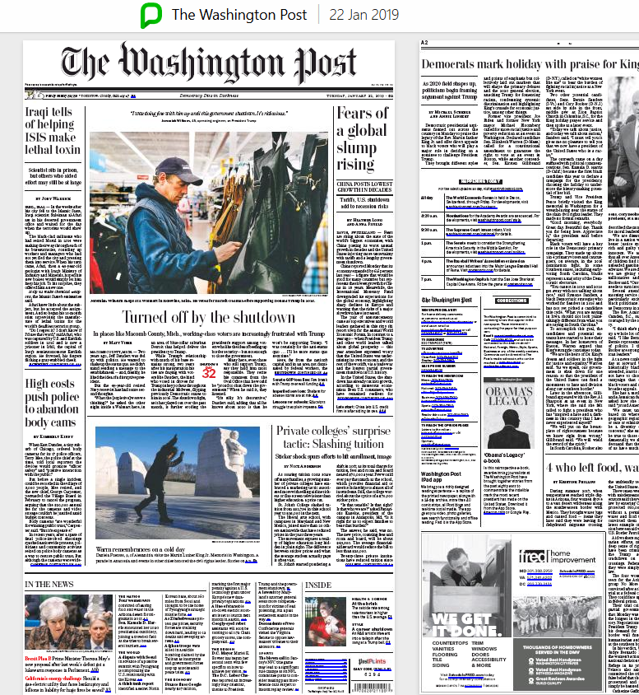

Slide 63
Search for older articles
Factiva
LexisNexis Library Express
Newspaper Source

Slide 64
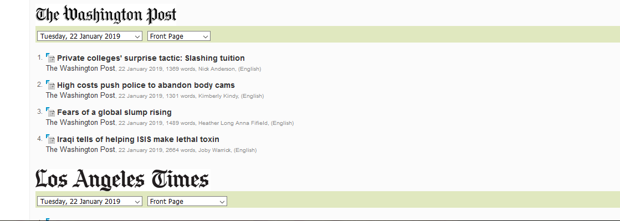
News Pages, then click on Factiva page, scroll down to Washington Post

Slide 65
Navigating Factiva
Click the day you want from the dropped down menu
Click the section of the newspaper you want
Scroll through the articles and then click on the articles to read it

Slide 66
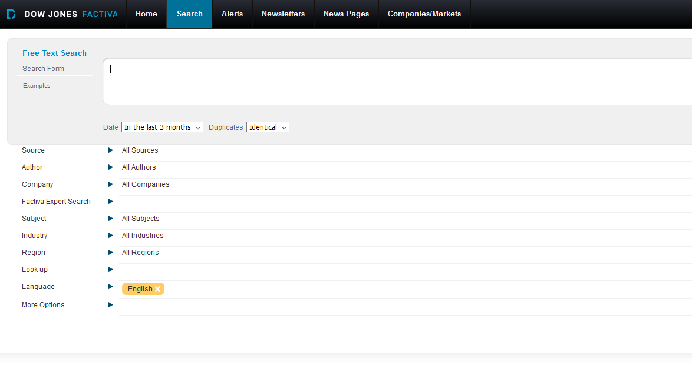
Search for a specific article

Slide 67
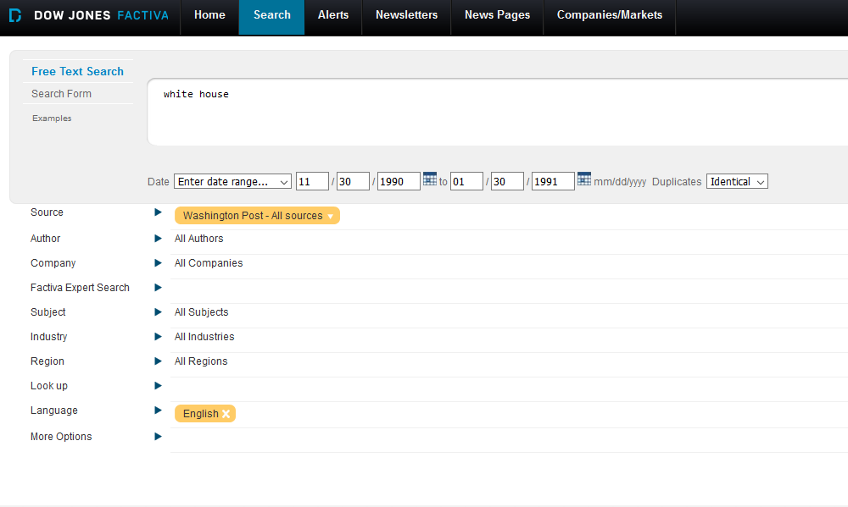
Search for a specific article

Slide 68
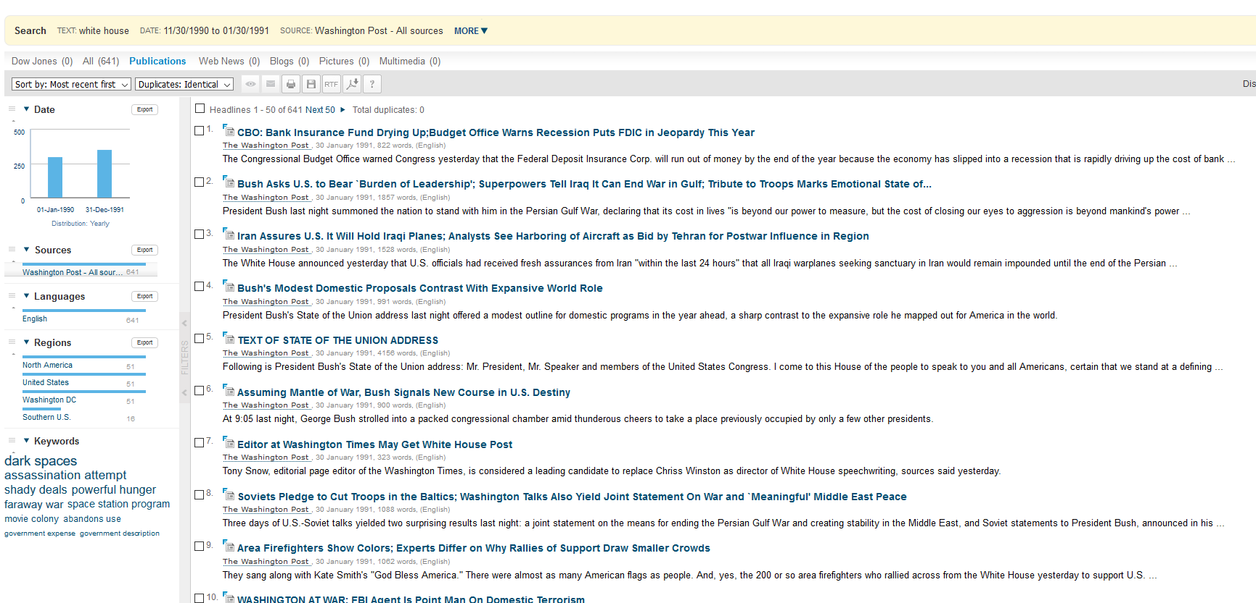
Search Results

Slide 69
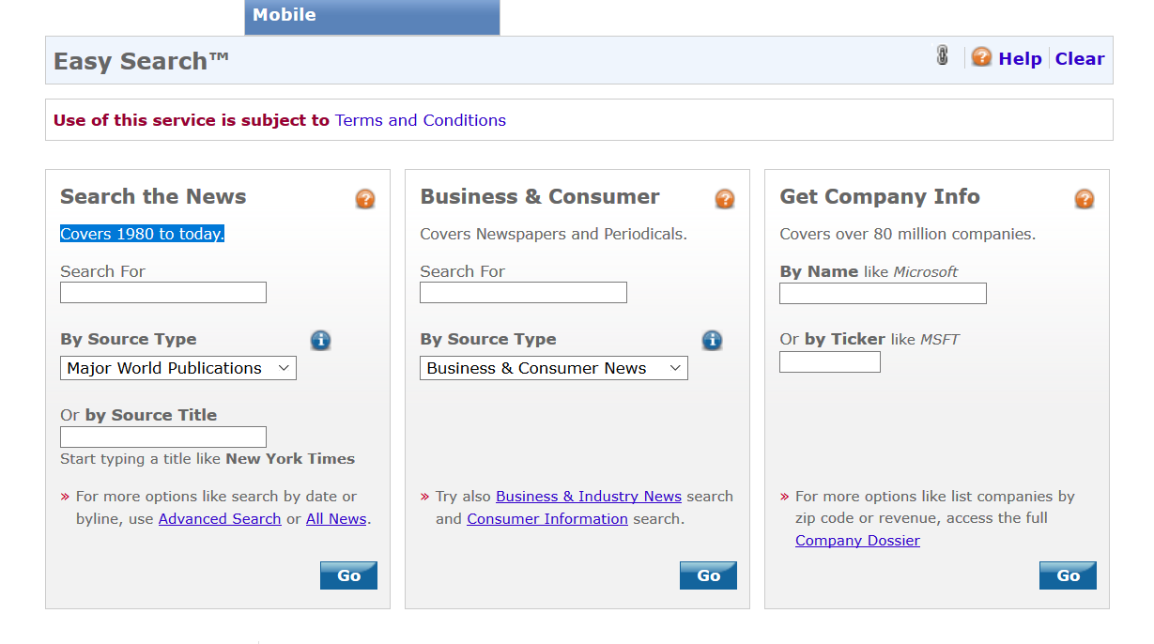
LexisNexis Library Express
Covers 1980 to today.
Not as user friendly
Strengths:
  Looking for legal information from U.S., Illinois or other jurisdictions.
  Looking for corporate contact information-especially email addresses.
  Looking for obscure information [news].
Notes:
LexisNexis Library Express has 3 sections, News, Legal and Companies.
News provides access to articles from more than 2,500 Newspapers, 1,000 magazines and journals, wire services, broadcast transcripts .
The legal area provides access to Federal and State court decisions, regulations and codes for the United States and all 50 States, articles from over 500 law reviews and 300 legal newspapers.
The Information on companies includes contact information including email addresses as well as corporate hierarchies from the Corporate Affiliations database.

Slide 70
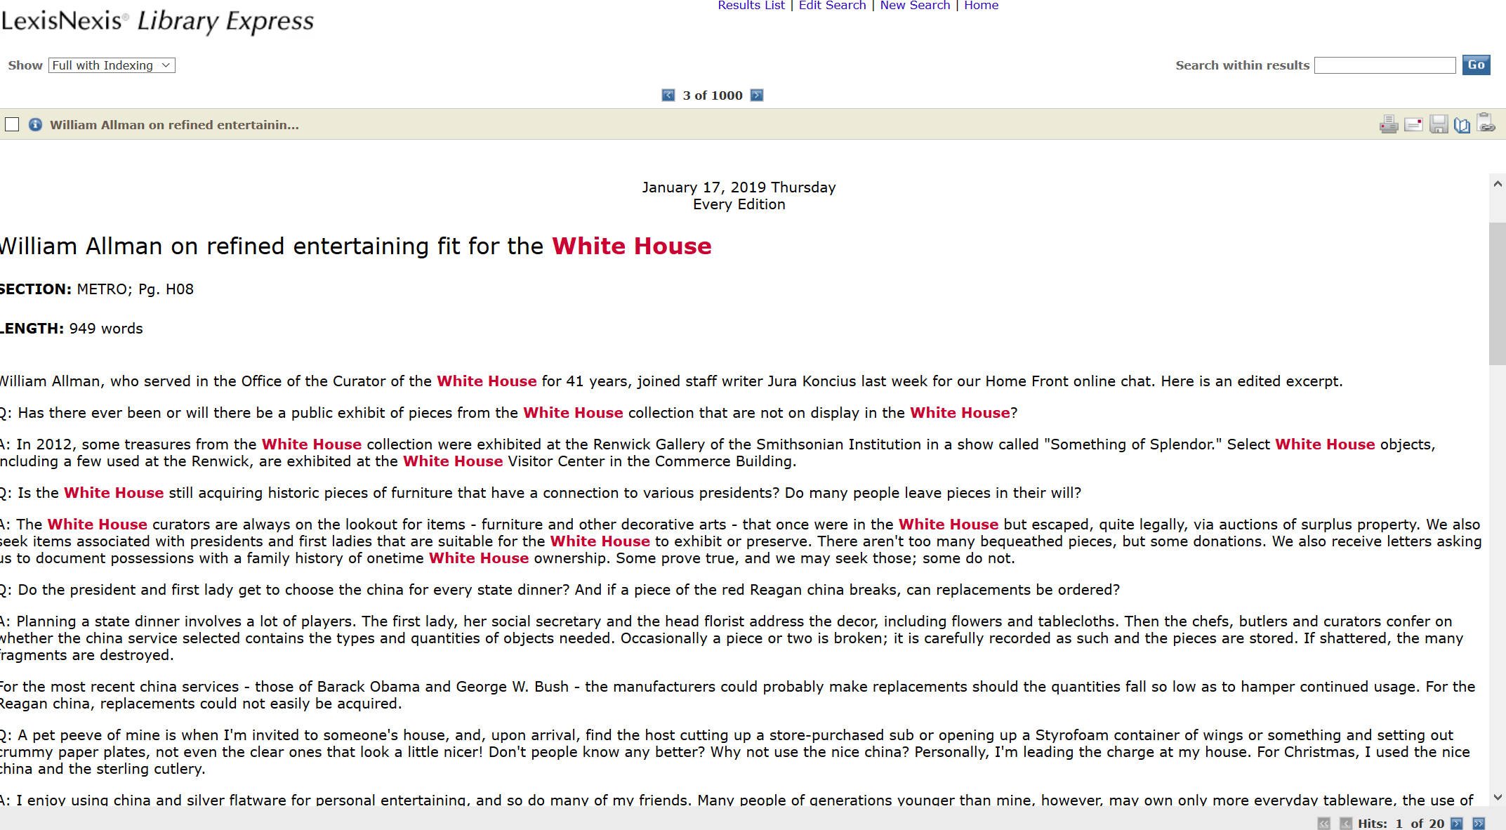
Article with search terms highlighted.
You can print, email, download or send a link to the articles

Slide 71
Newspaper Source
Full-text articles from hundreds of U.S. and international newspapers
Full-text transcripts from CNN, Fox News, and NPR.
https://skokielibrary.info/resources/research/articles/
Notes:
Full-text articles from hundreds of U.S. and international newspapers such as The Washington Post and USA Today; also features transcripts from CNN, Fox News, and NPR.

Slide 72
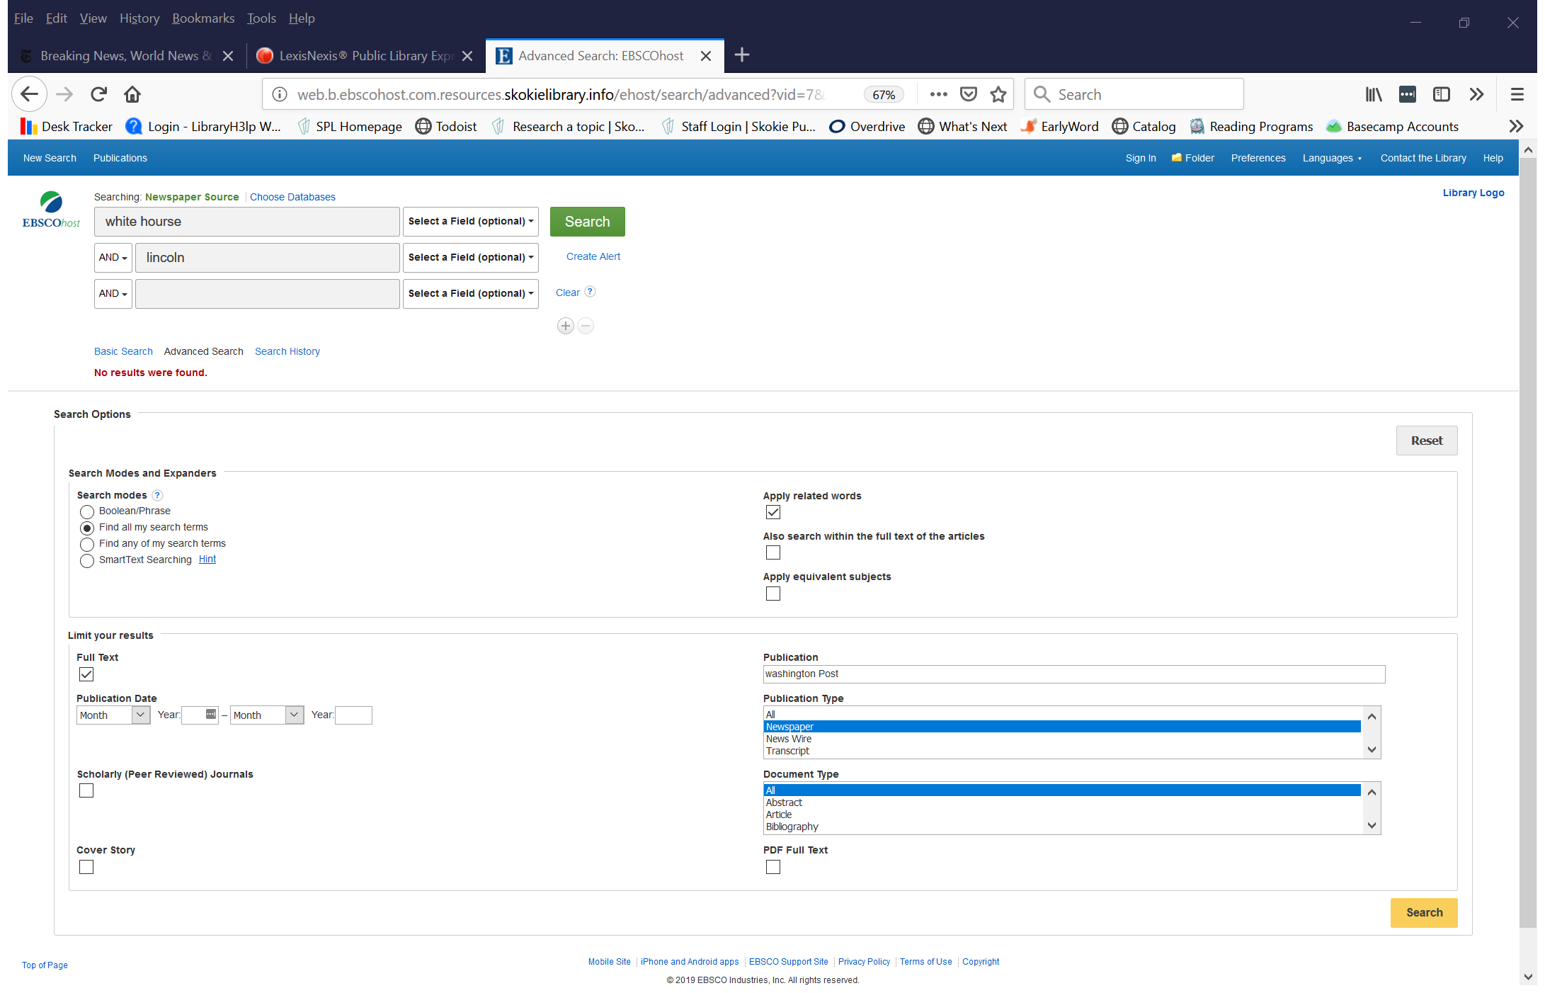
Searching for articles

Slide 73
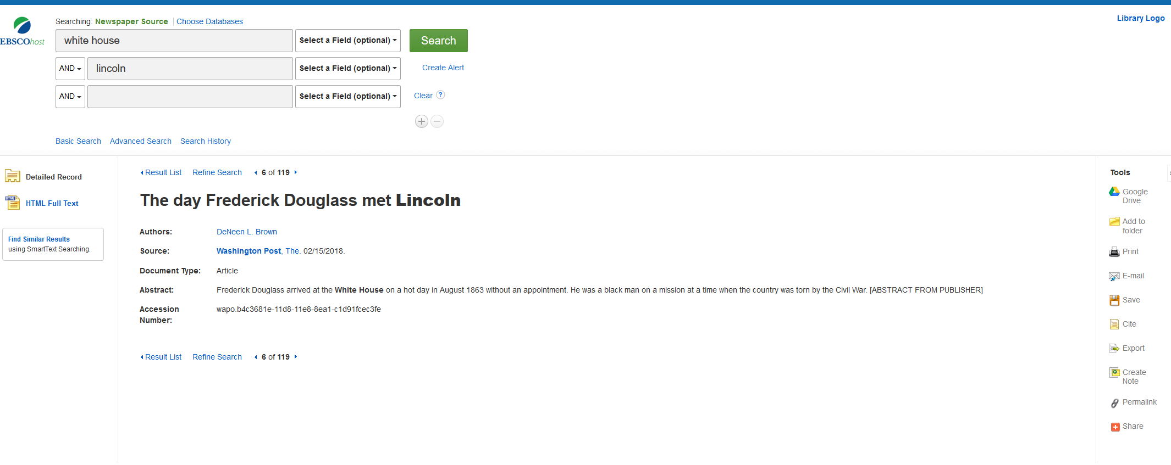
Article example

Slide 74
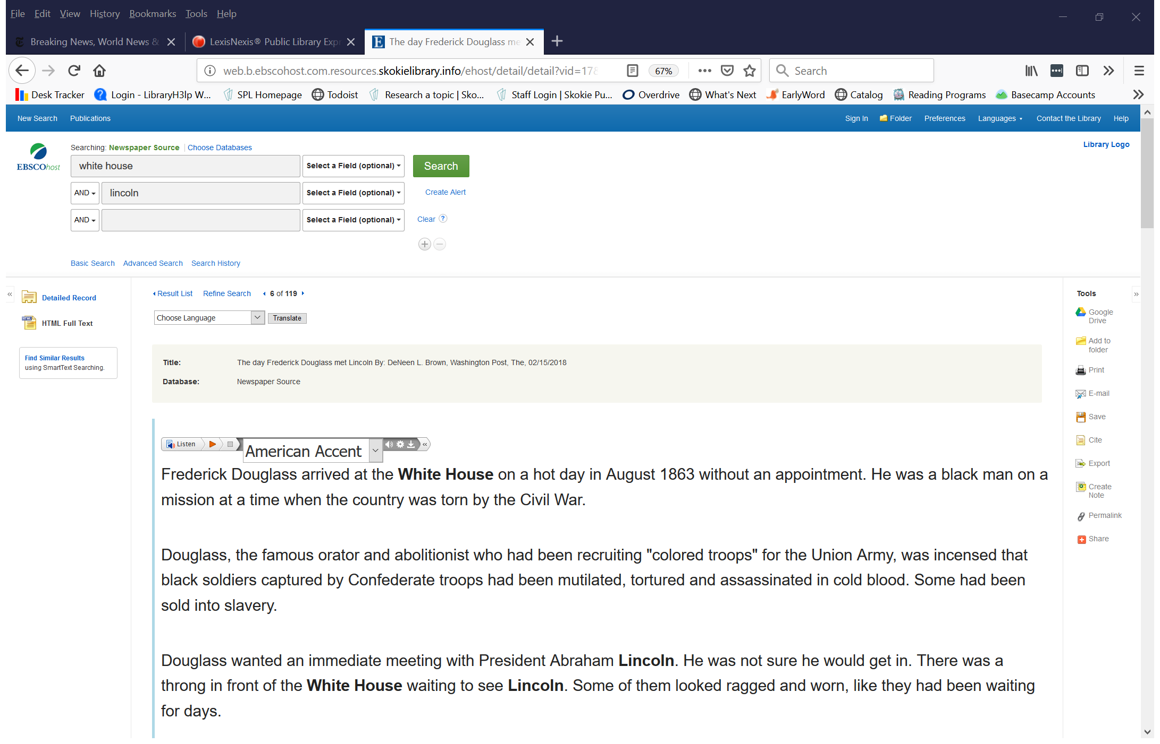
Notes:
Can have it read to you. Can print, email, save, export or save to google drive

Slide 75
Thank You
Want a copy of this presentation?
Visit www.skokielibrary.info/handouts
where this presentation will be available
for four weeks.

